Slide 1

BRAND COMPARISON
Exploratory Data Analysis on

Slide 2
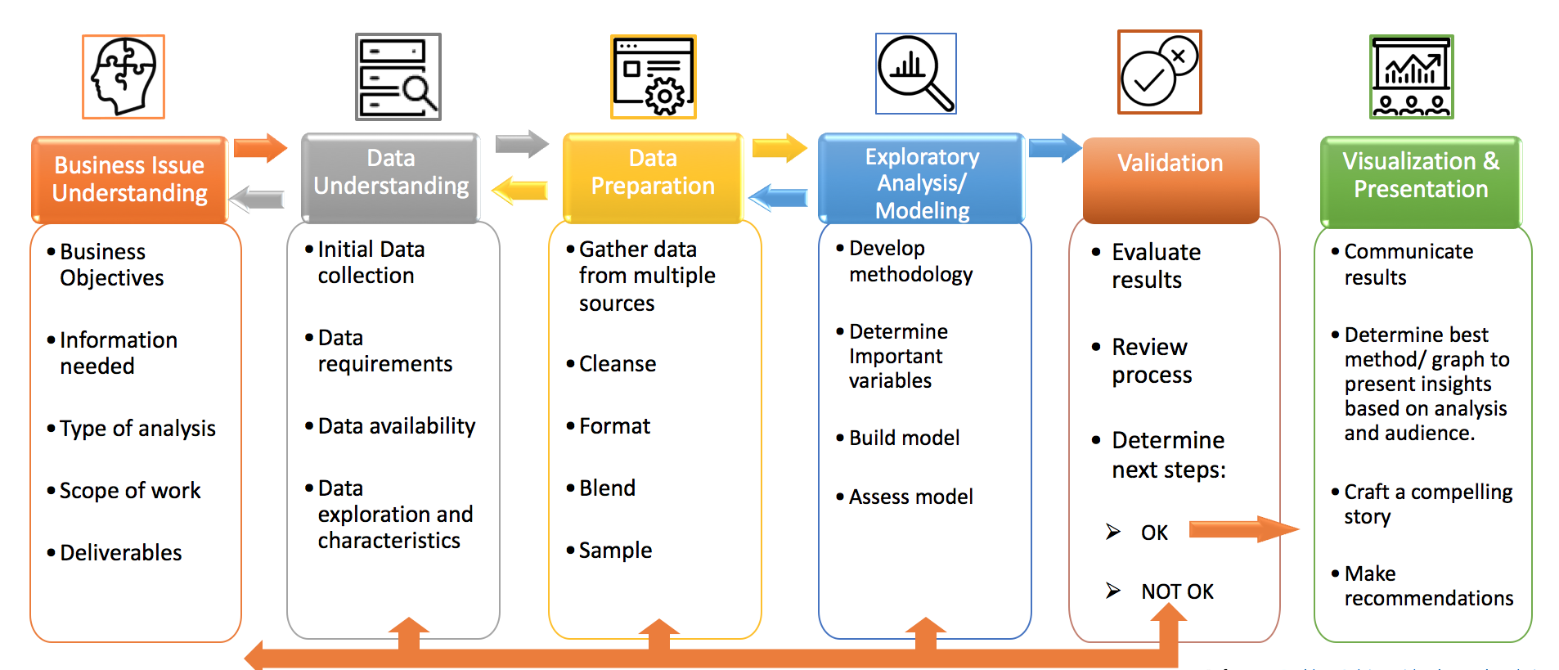
Process of Data Analysis

Slide 3
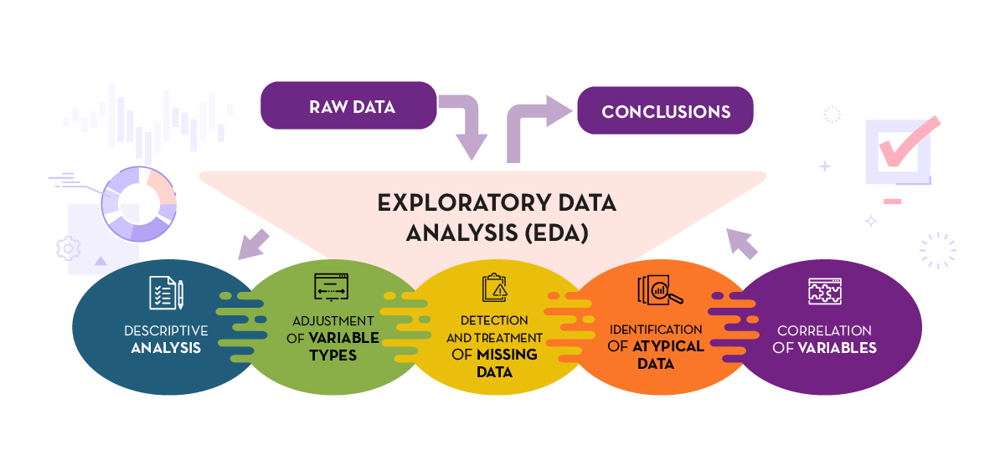
What is EDA?

Slide 4


Slide 5



Analysis on product/brand comparison
Here we consider two Brands for analysis ( REALME & SAMSUNG ). We have to go through EDA one by one
and interpret the same.

Slide 6
Scope
Helps us to learn Web scrapping /Data analysis and Visualization.
It also widens up with concept of EDA .
Helps to understand Comparison of different products .
To do real time analysis.

Slide 7
Requirement Of Case study
Data Collection ( Web Scrapping)
Data Cleaning (Null or missing values/Zero Values)
Data Transformation
Data Wrangling
Data Visualization

Slide 8
Process :
Process 1 :
Samsung data
Process 2 :
Realme data
Process 3 :
New Data(merging both the data)
Process 4 :
Data Analysing / Filtering
Process 5 :
Data Visualization & Interpretation

Slide 9
Data Scrapped : Flipkart
Samsung Data : https://www.flipkart.com/search?q=samsung+mobiles&sid=tyy%2C4io&as=on&asshow=on&otracker=AS_QueryStore_OrgnicAutoSuggest_1_4_na_na_na&otracker1=AS_QueryStore_OrganicAutoSuggest_1_4_na_na_na&aspos=1&astype=RECENT&suggestionId=samsung+mobiles%7CMobiles&requestId=9dc9bd11-253a-4656-a341-1261737a1588&as-searchtext=sams
Realme Data : https://www.flipkart.com/search?q=%20realme%20mobile&otracker=search&otracker1=search&marketplace=FLIPKART&as-show=on&as=off
Libraries Used :
BeautifulSoup - Web-Scrapping
Urlopen
Pandas - Data Frame
Numpy - Mathematical Calculation
Matplotlib - Graphical Presentation
Seaborn

Slide 10
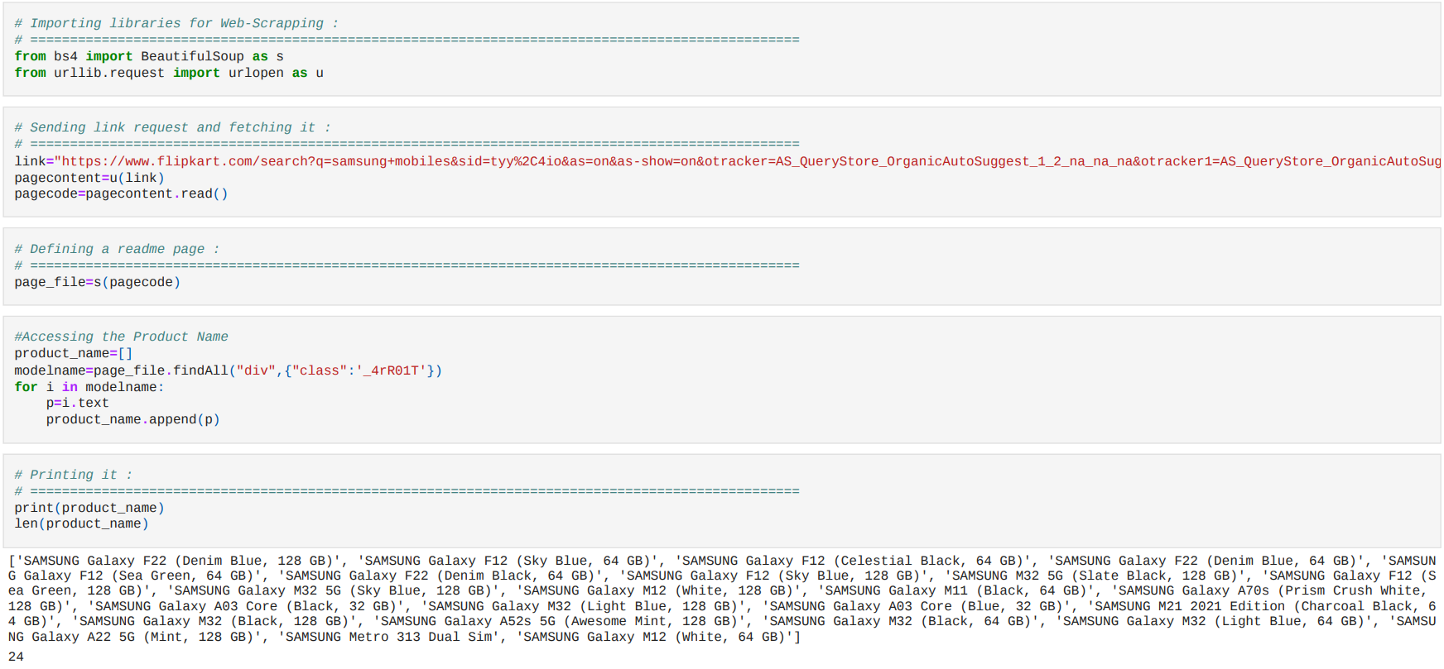
Samsung Data
Process 1 :
Web scrapping the Data :
Product Name Data

Slide 11
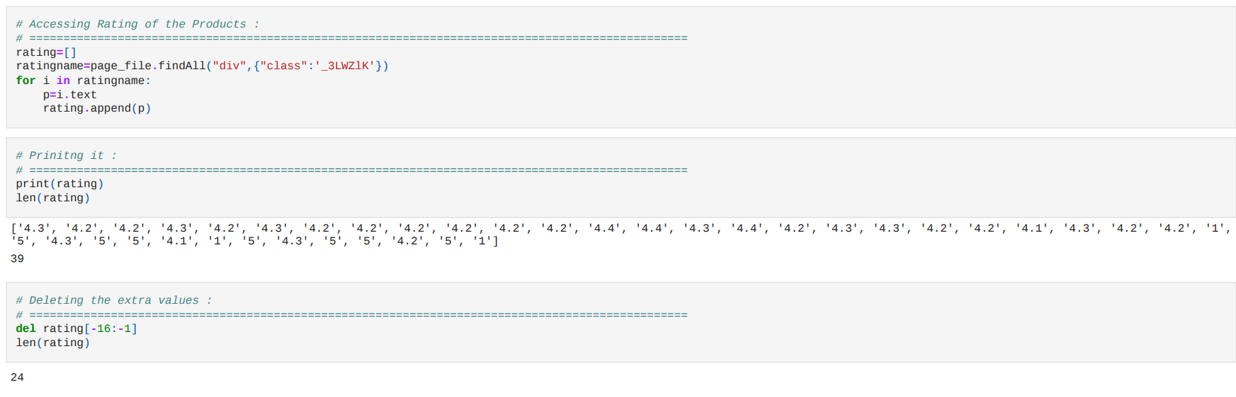
Rating Data
Length= 39
Length of all columns should be equal
Deleting the extra data

Slide 12
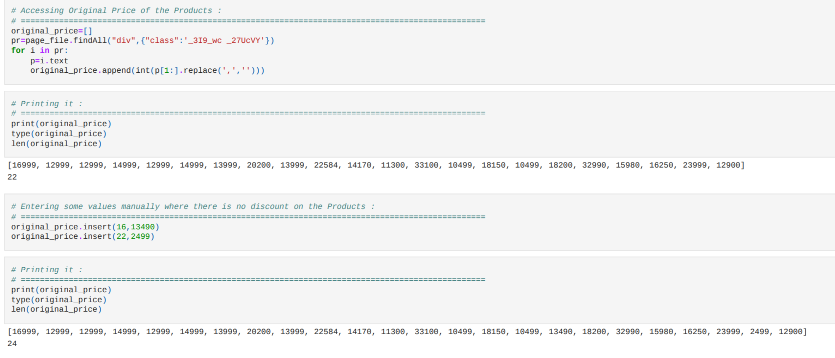
Original Price
Length =22 we need to add data
Manually adding

Slide 13
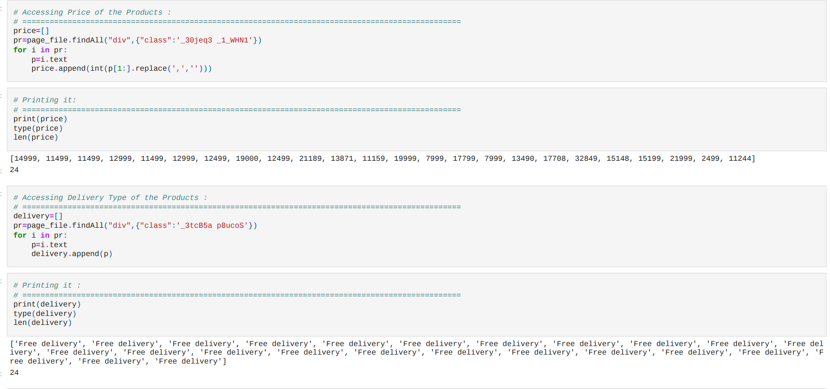
Price
Delivery

Slide 14
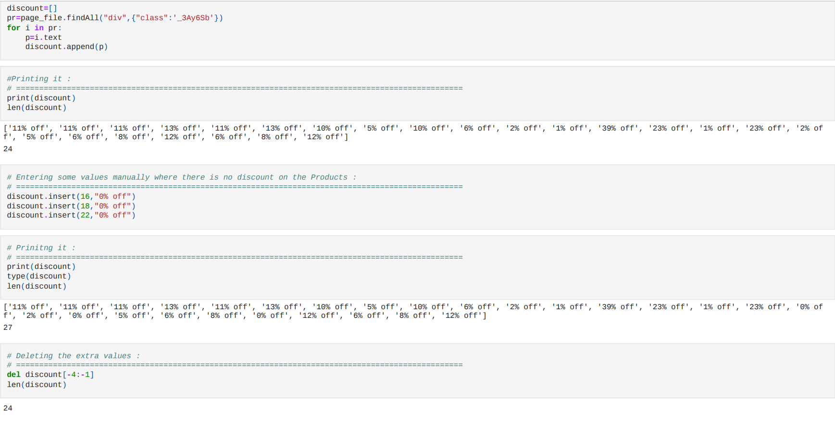
Discount Percent
The data has incorrect values
Length=27
Deleting the extra data

Slide 15
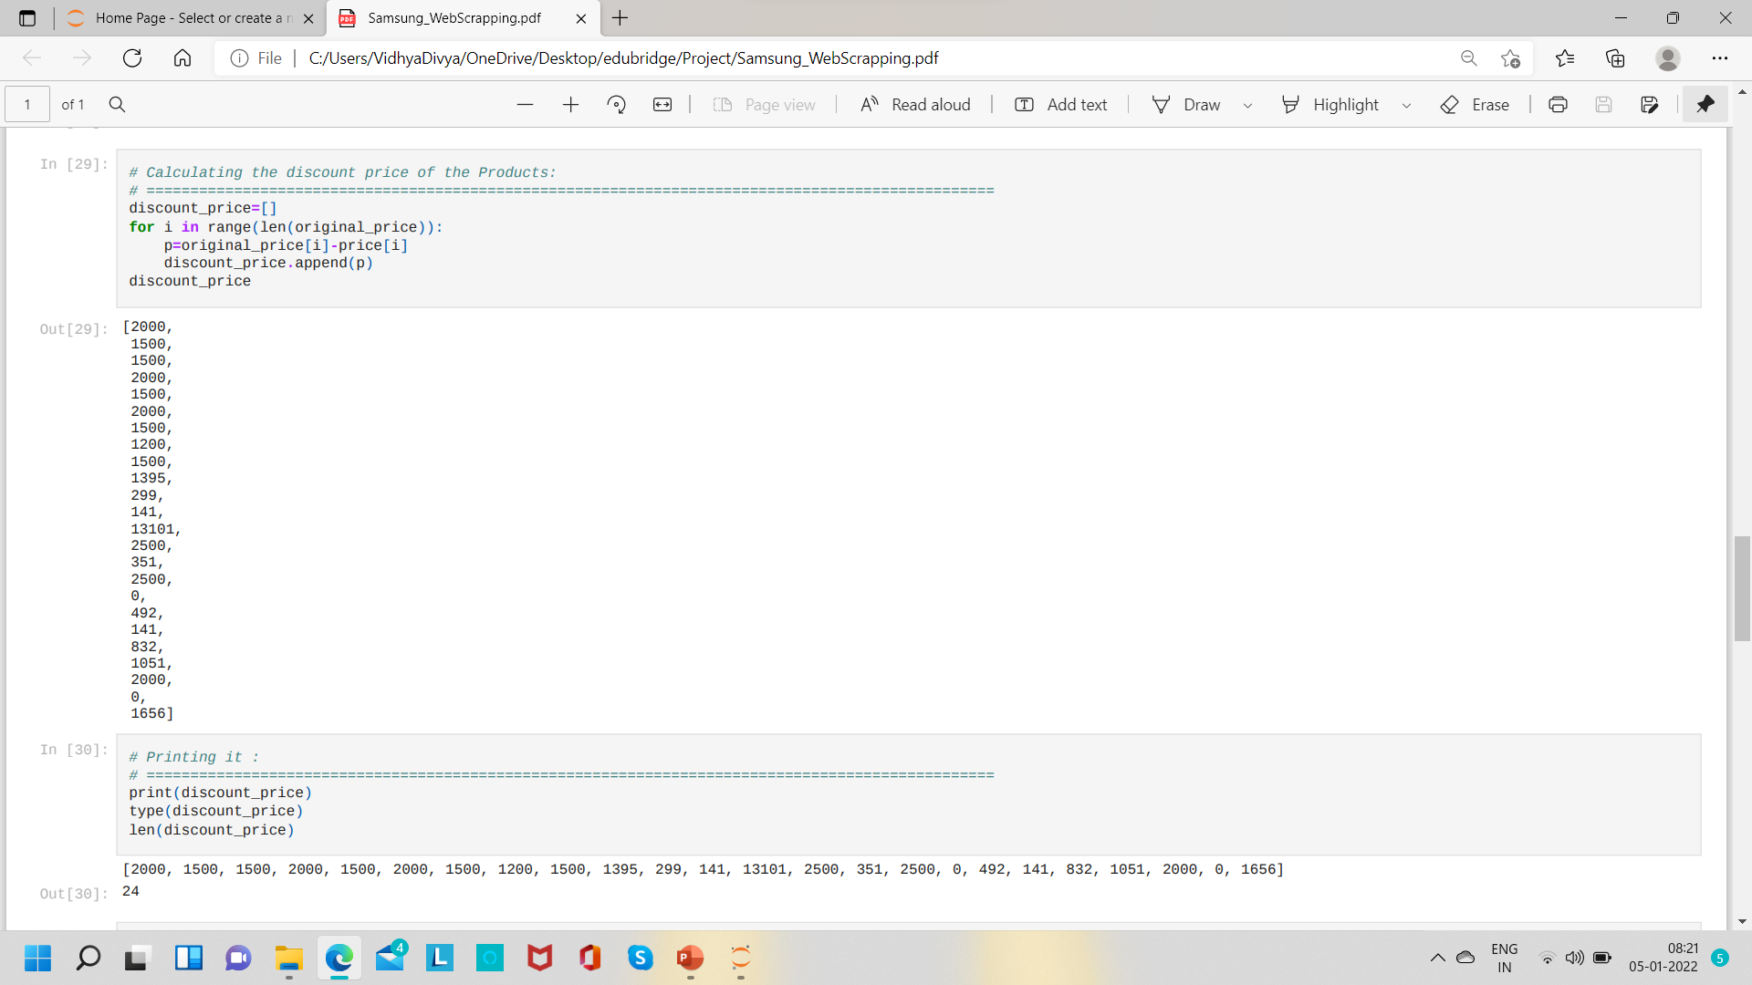
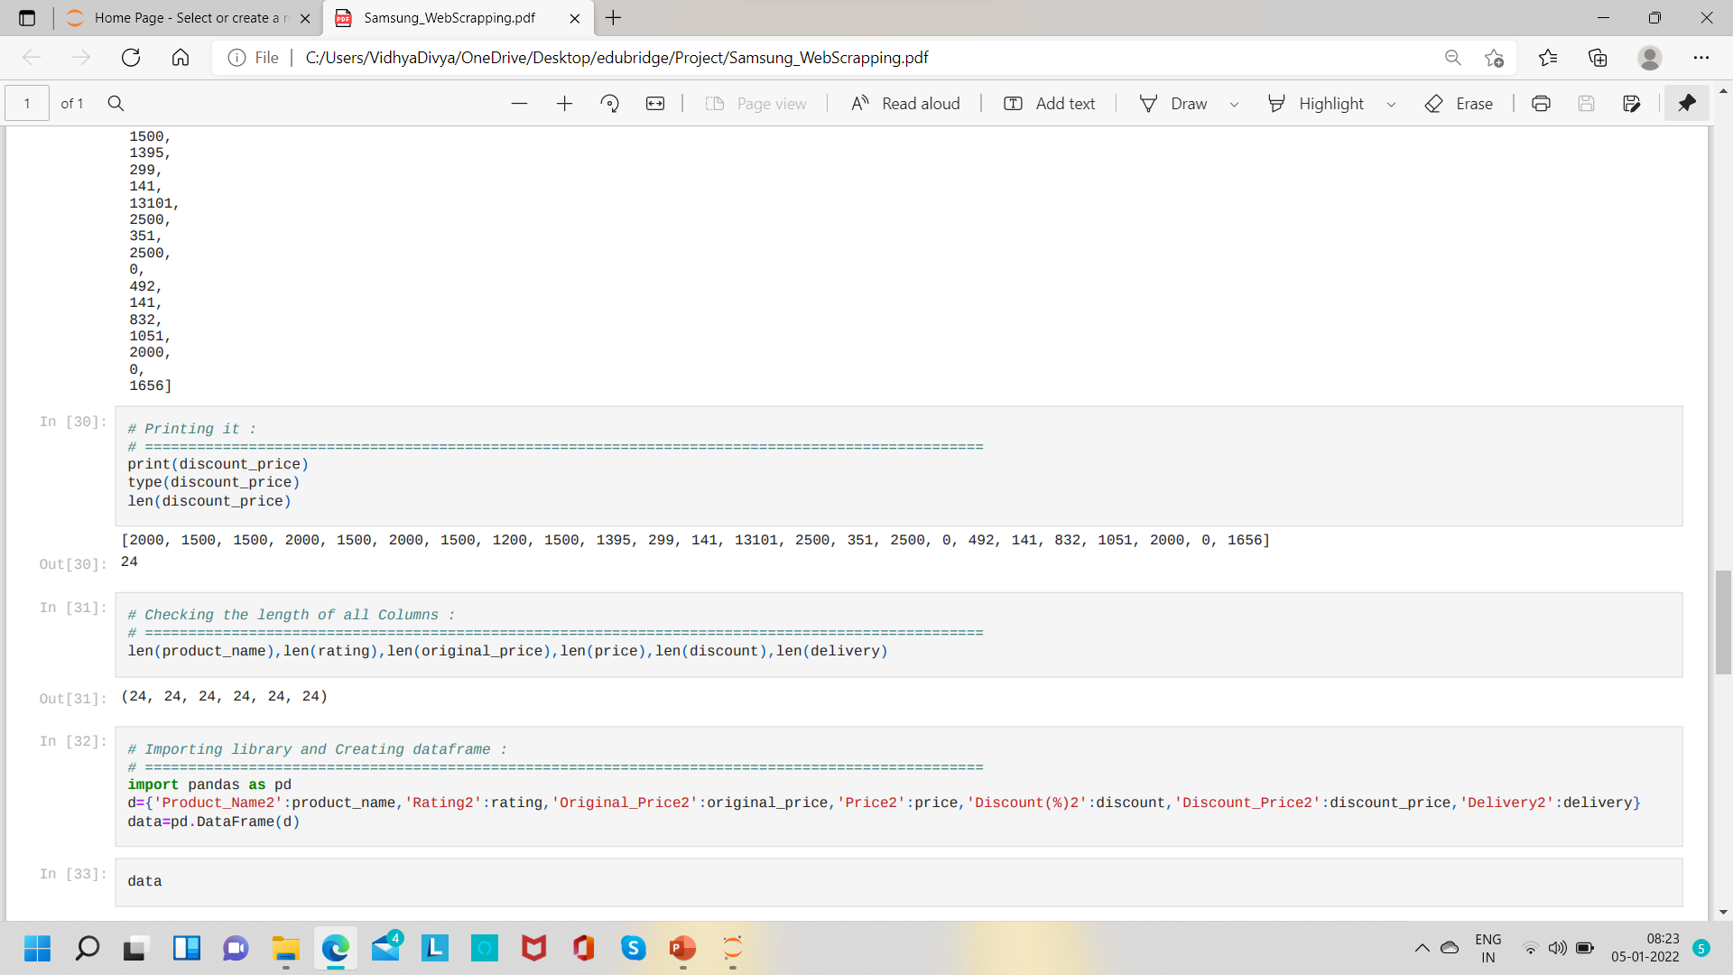
Discount Price
All length should be same ,
to create data frame

Slide 16
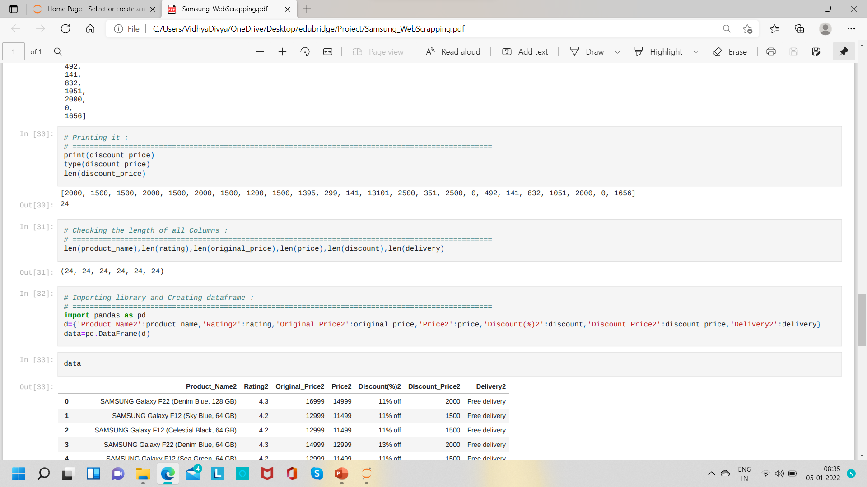
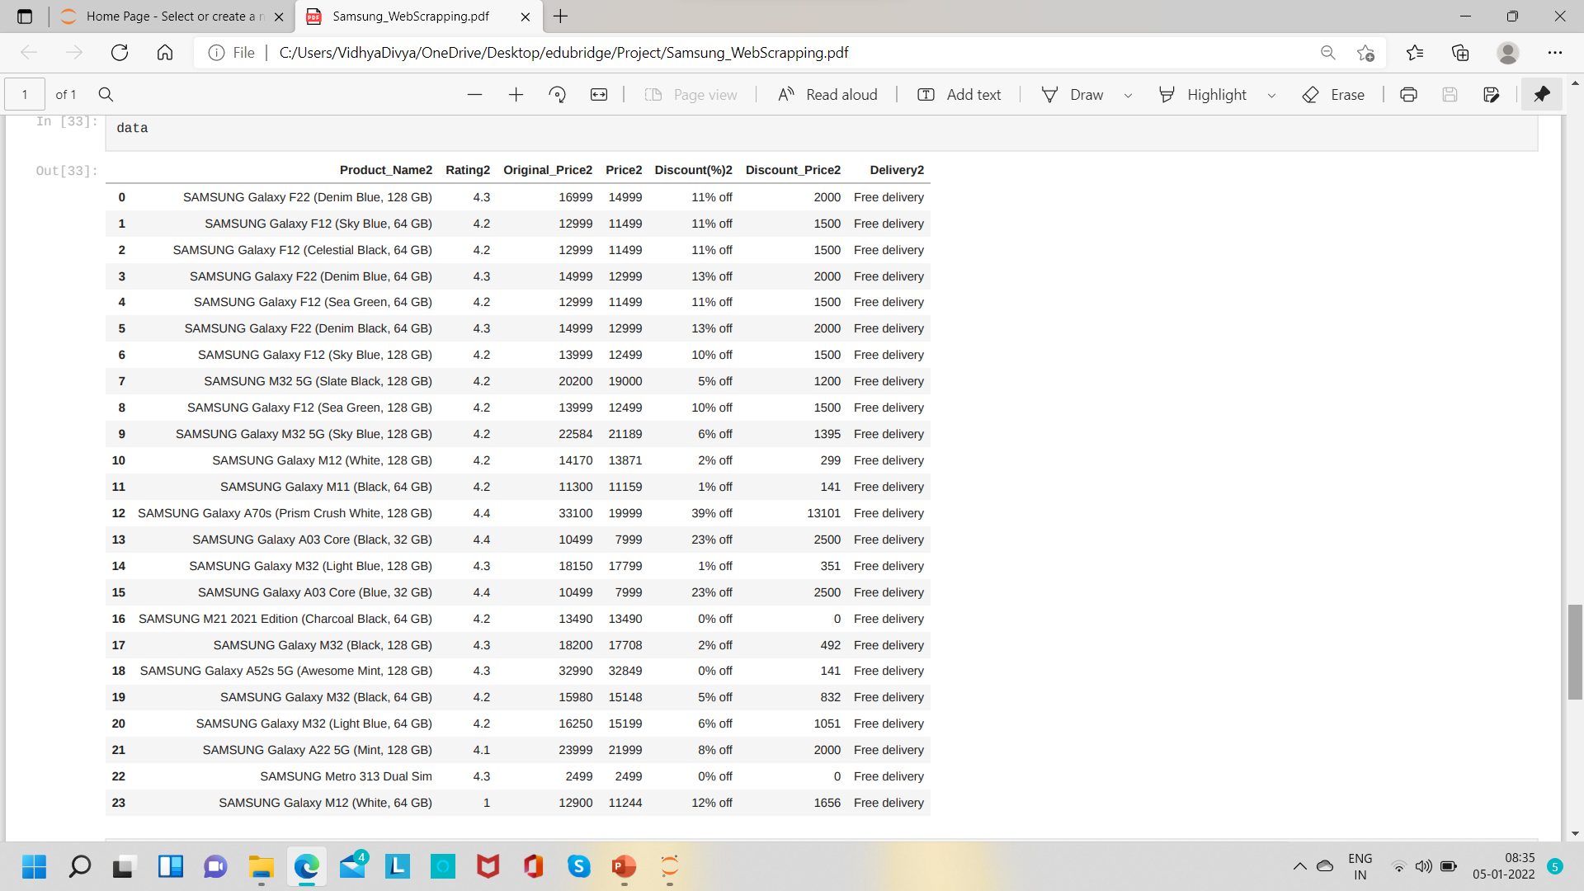
Here we have 24 records in it we need only 10 records for our analysis

Slide 17
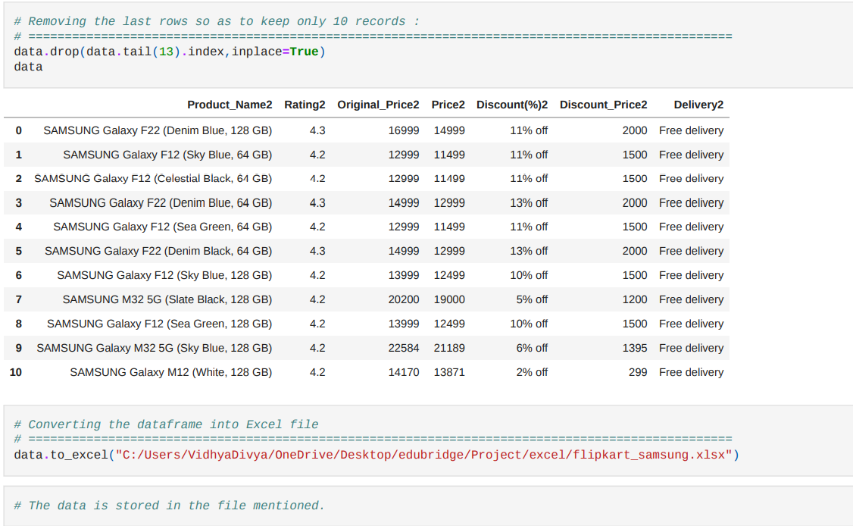
Dropping the records
Saving in the excel file
Saving in the excel file is one of the crucial step because the website gets update frequently. If the data is not saved the file will take the updated value while running which may leads to wrong data.

Slide 18
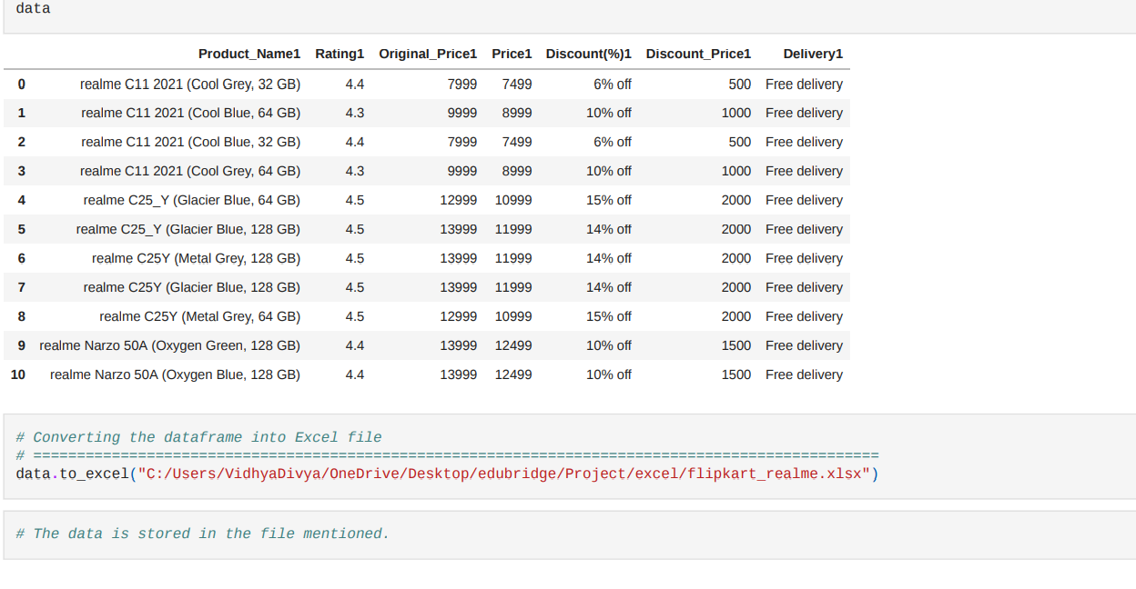
Process 2 :
Realme Data

Slide 19
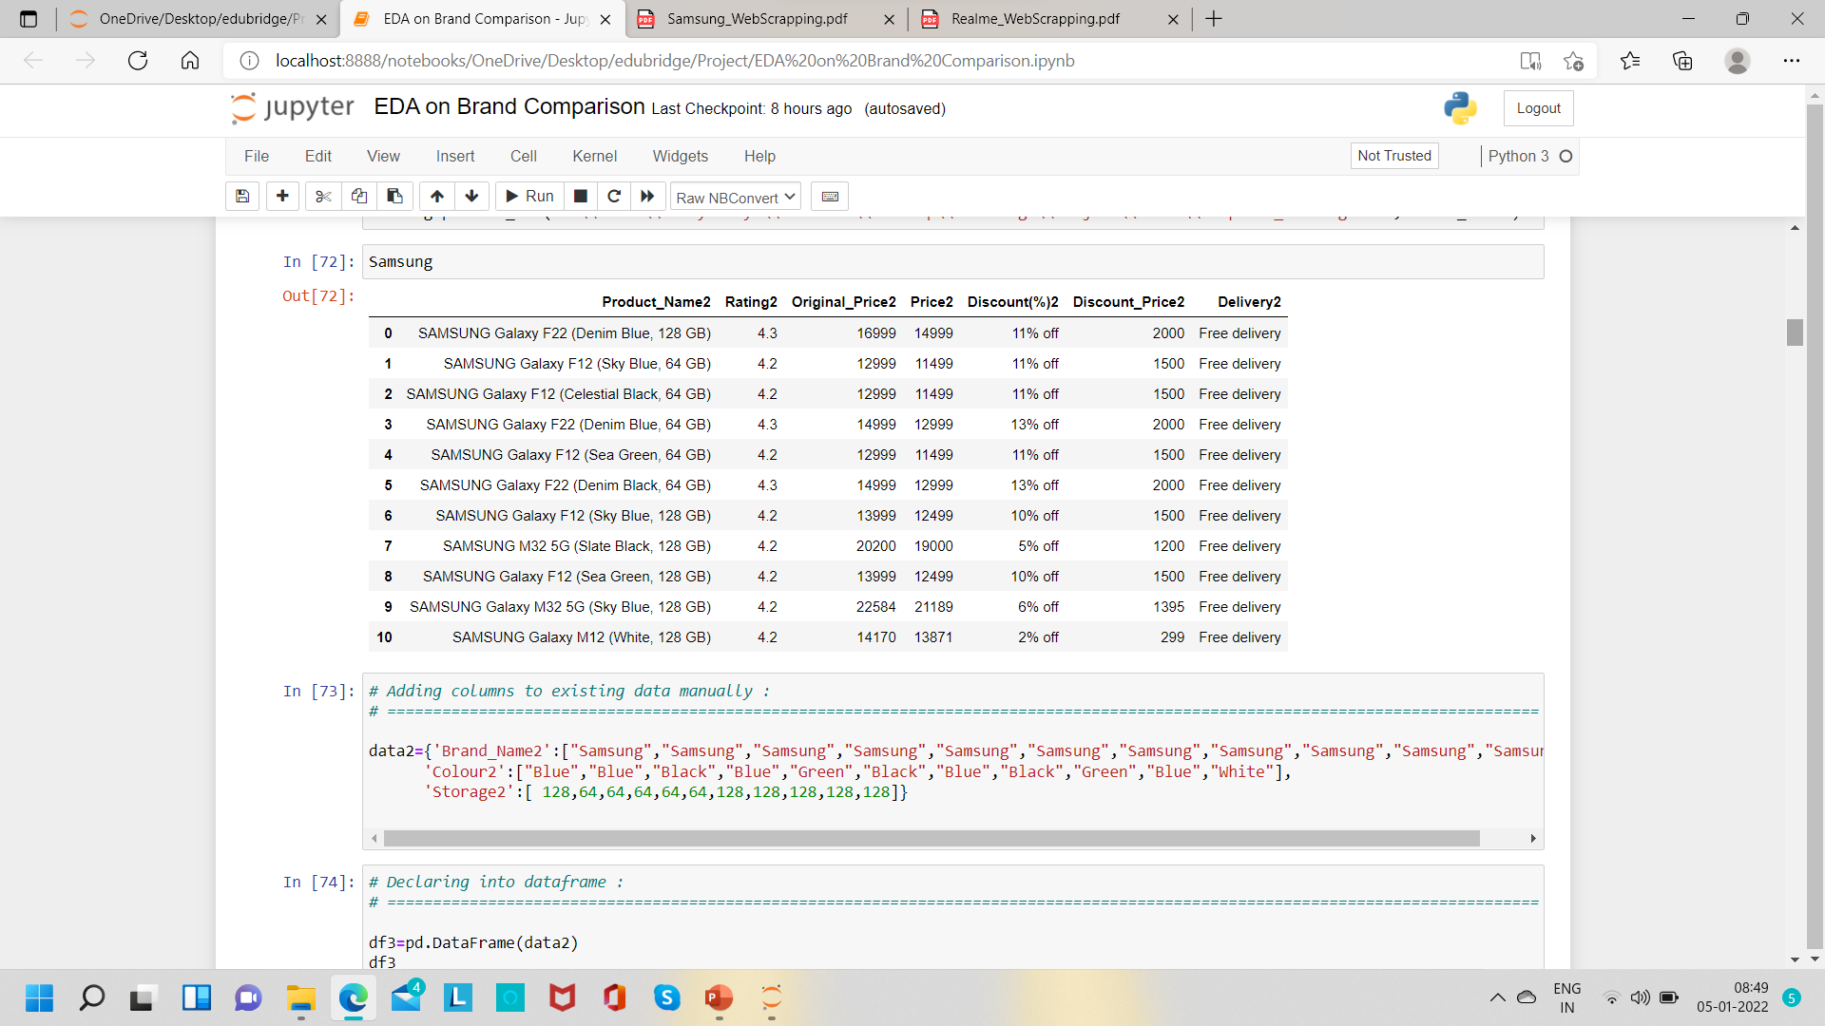
Process 3 :
Adding new columns & Merging Data

Slide 20
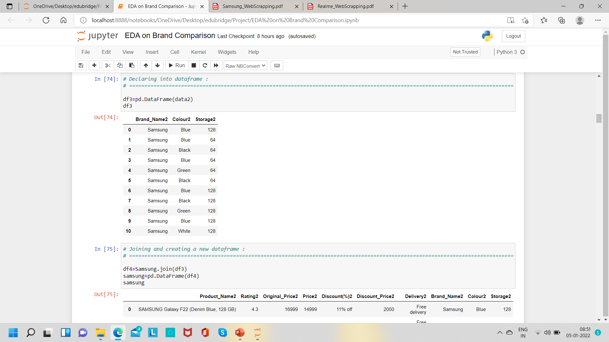
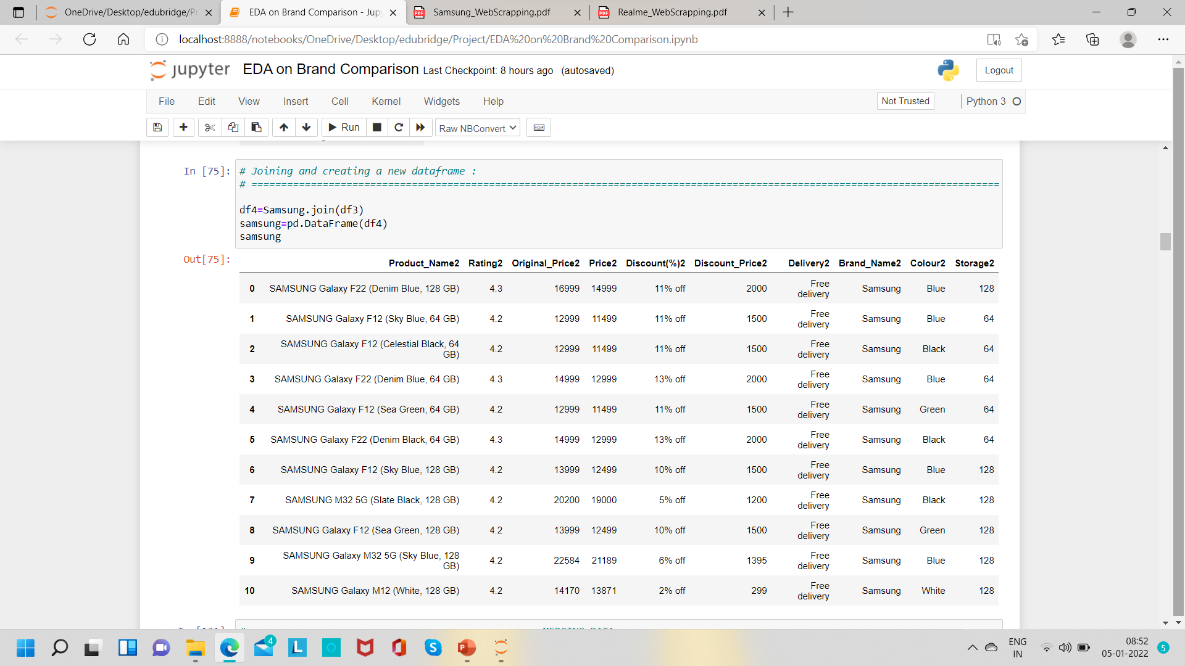
Joining data

Slide 21
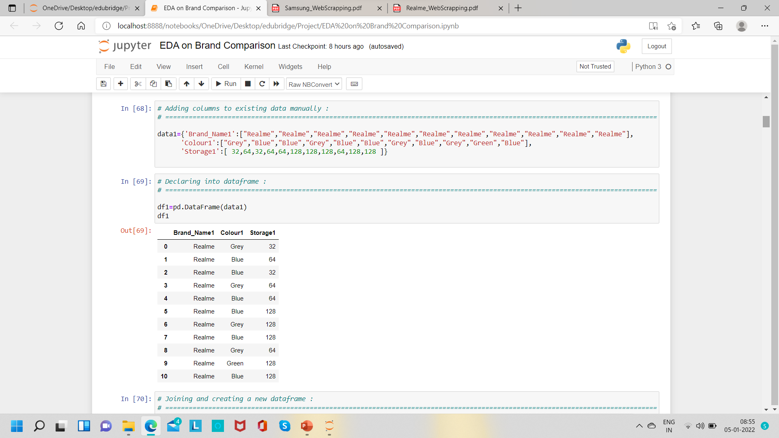
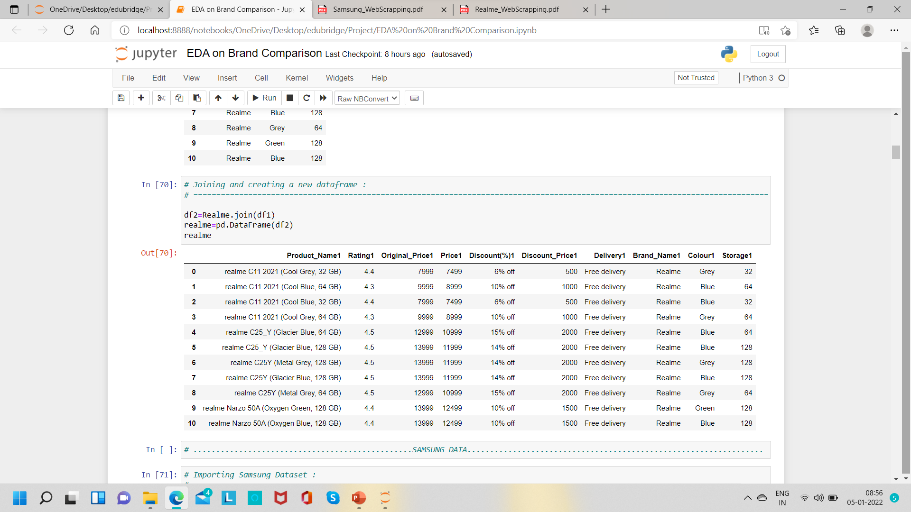
Adding data
Joining data

Slide 22
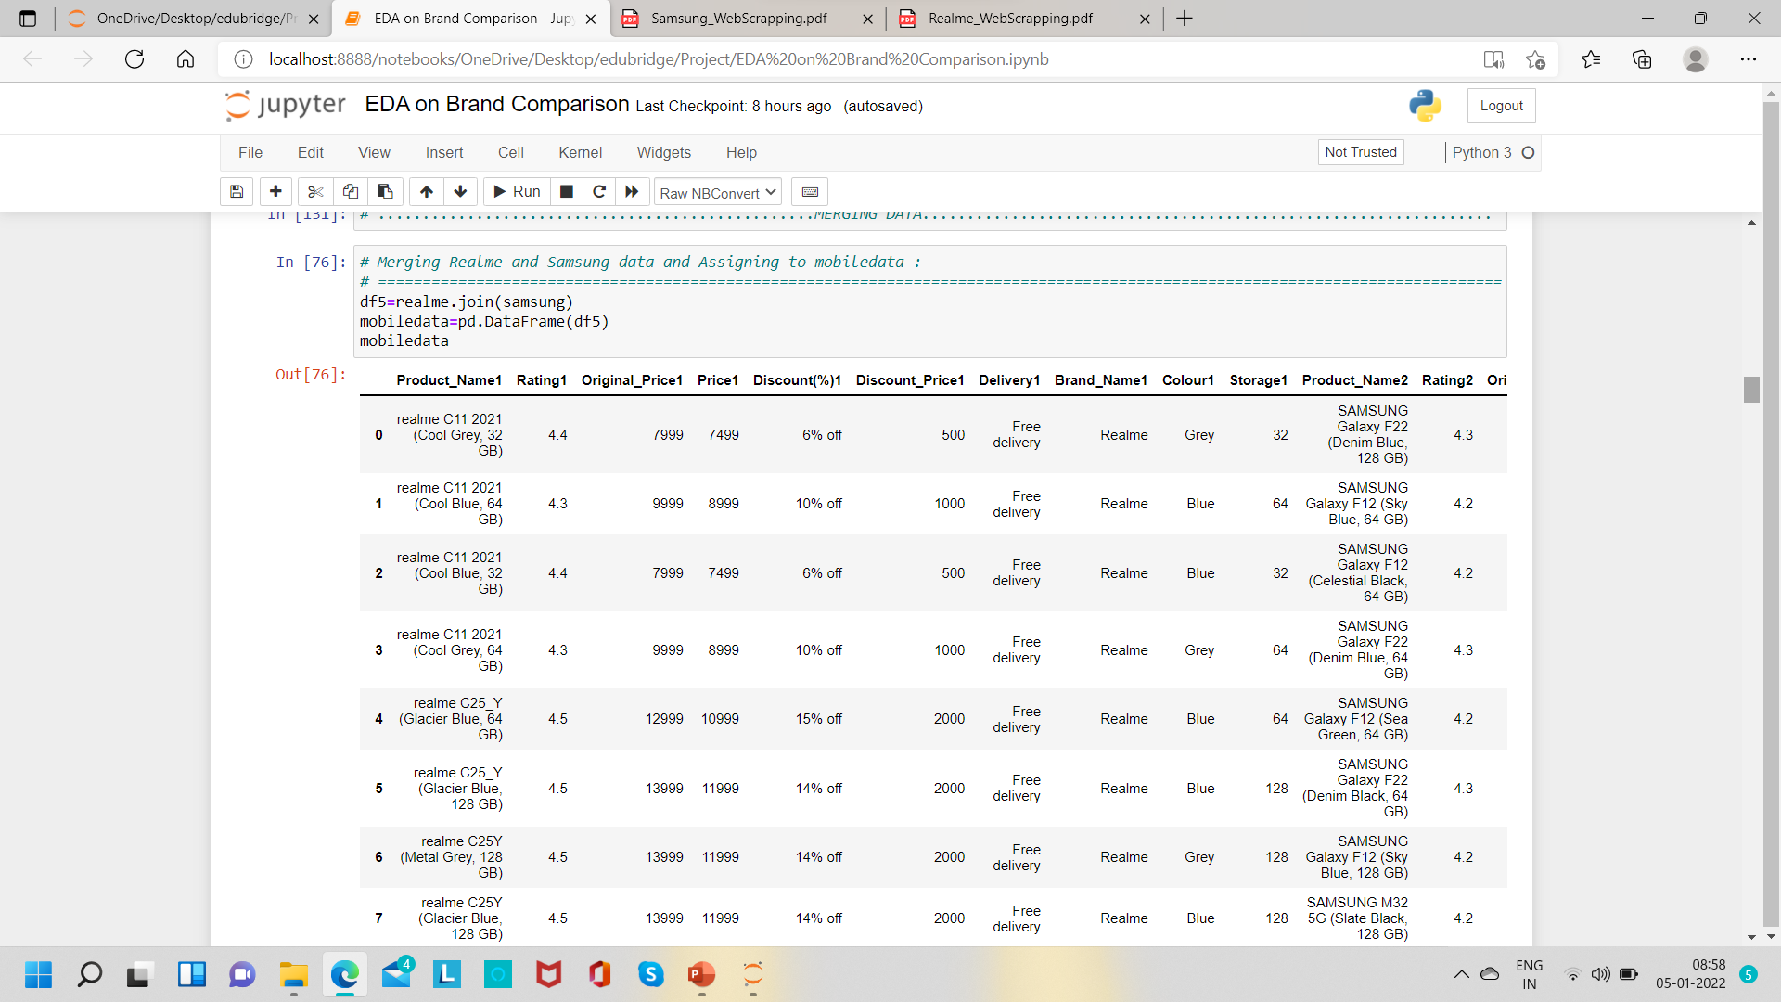
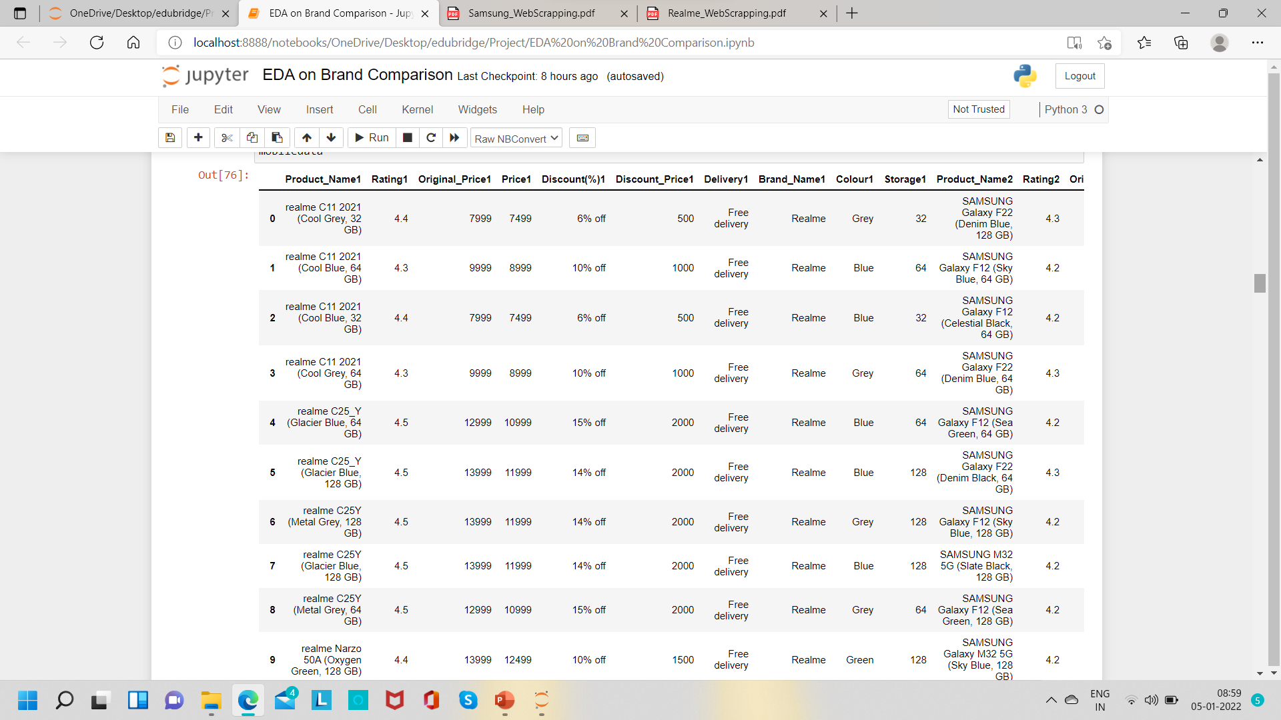
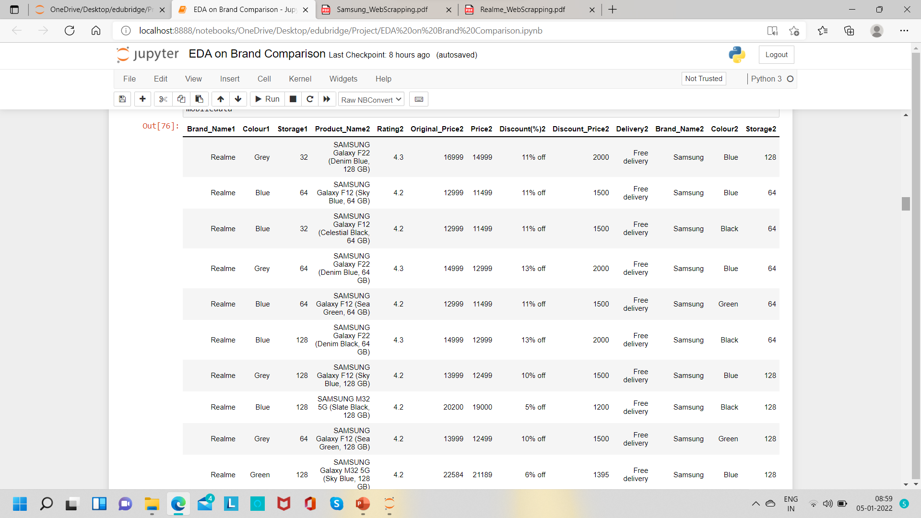
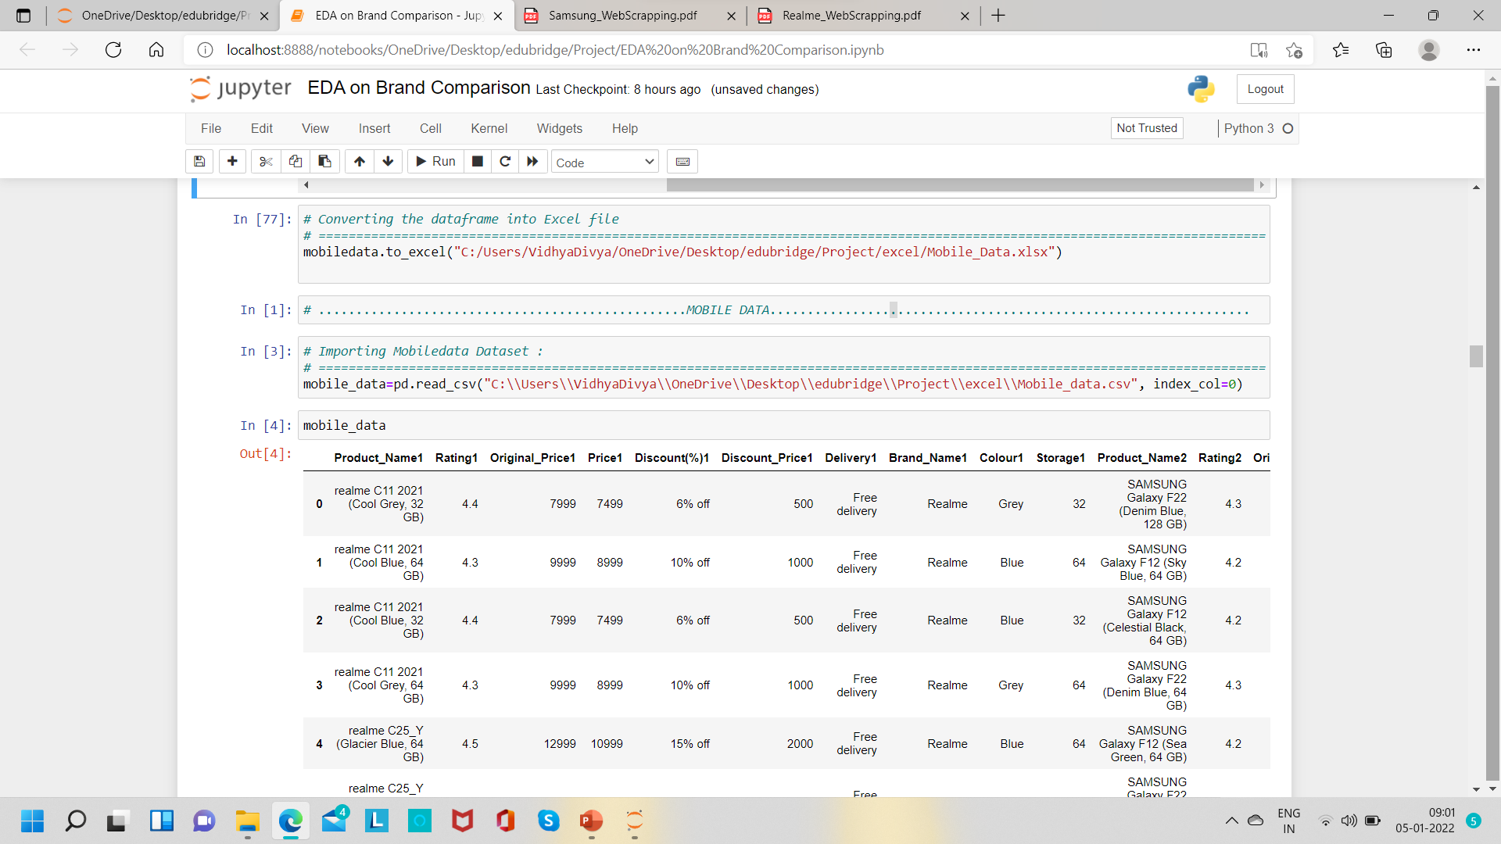
Joining data
CSV Format

Slide 23
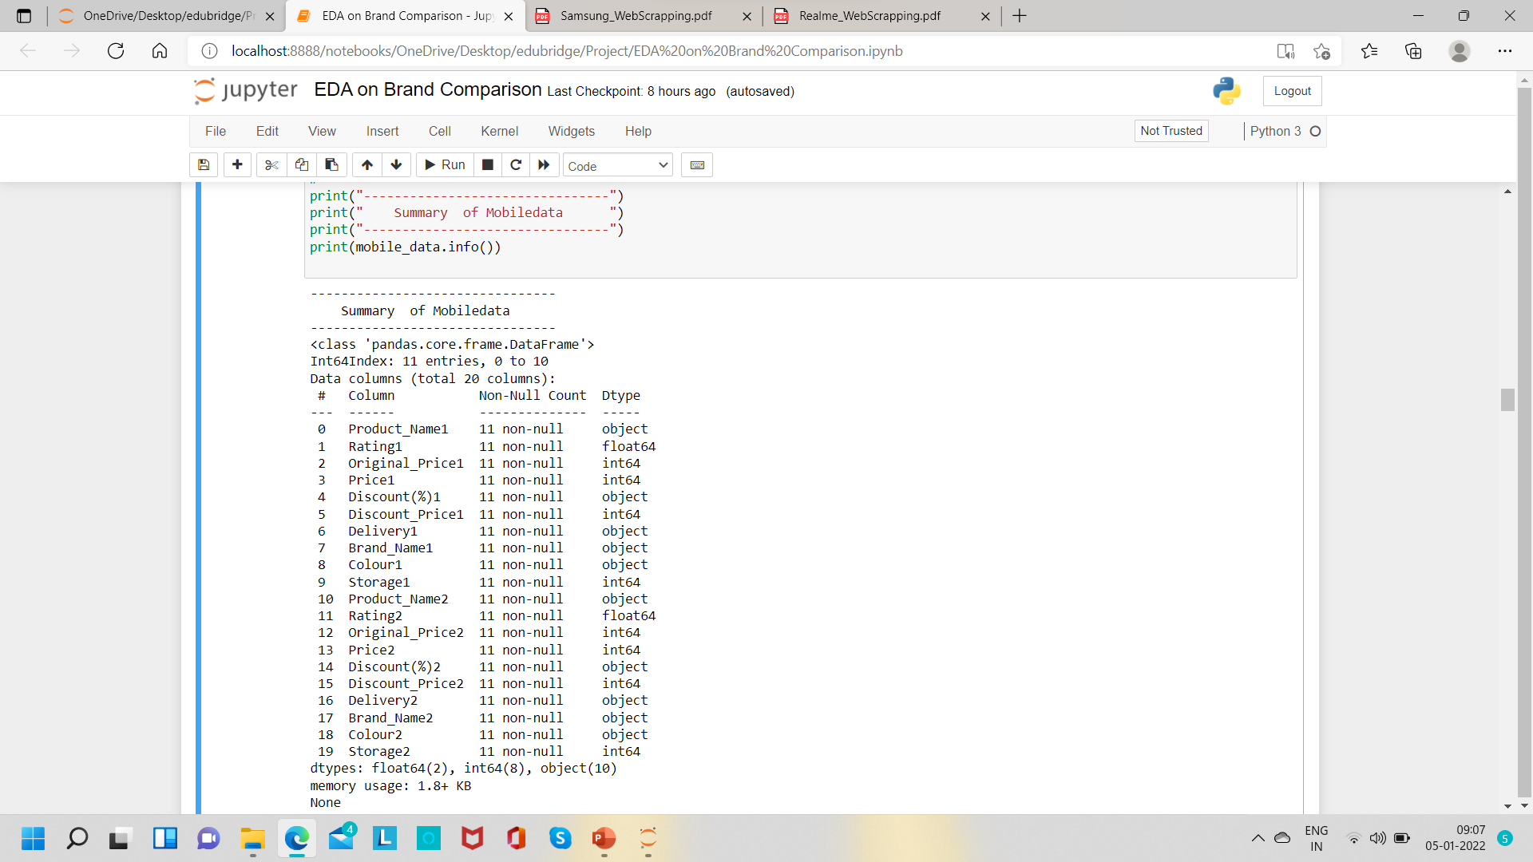
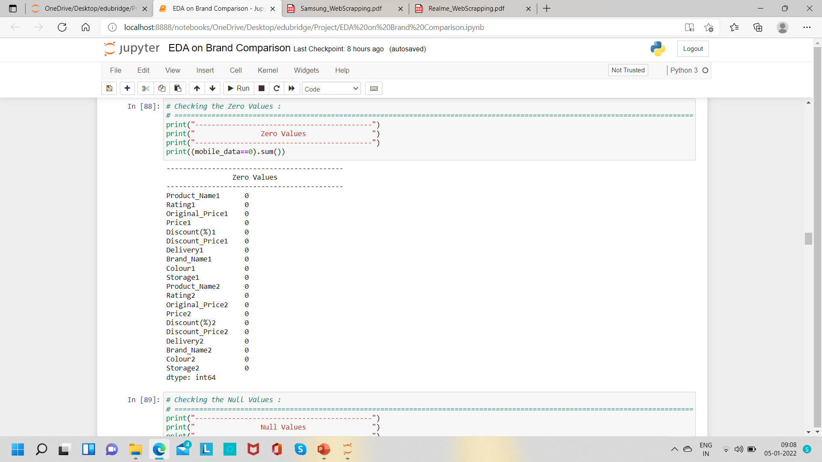
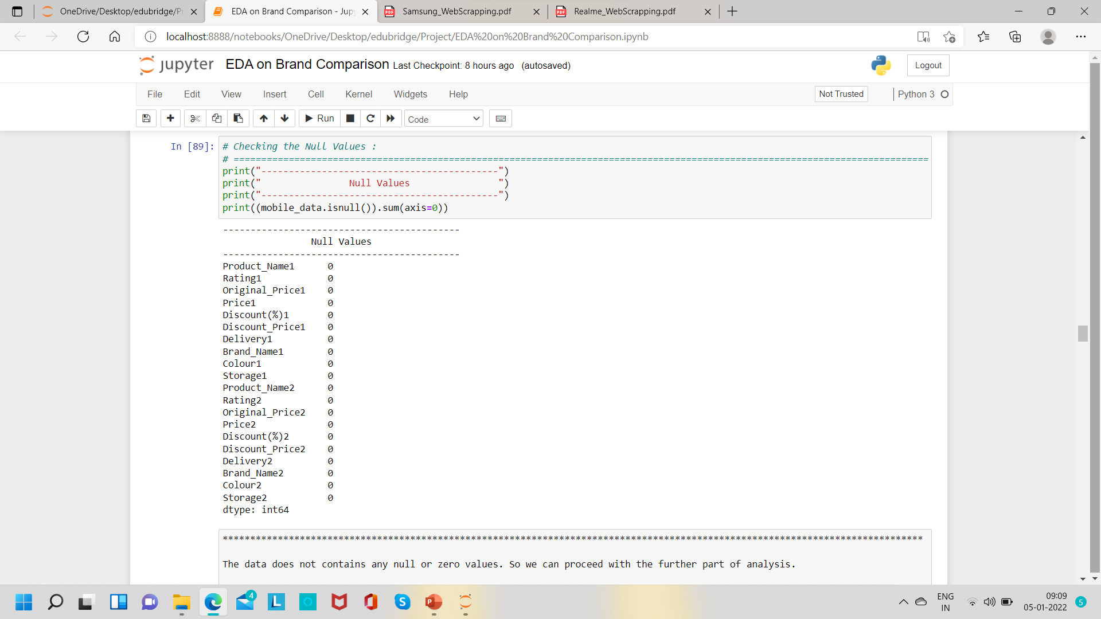
Process 4 :
Analysing the Data
Data is prefect to proceed .
(Data type are all correct/ Null ,Missing value and Zero values are absent )

Slide 24
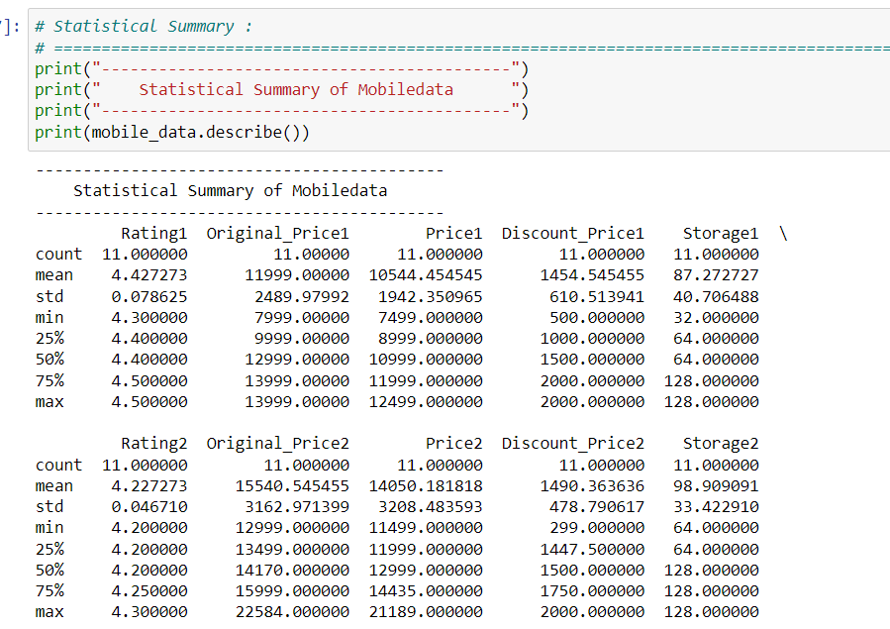

Slide 25
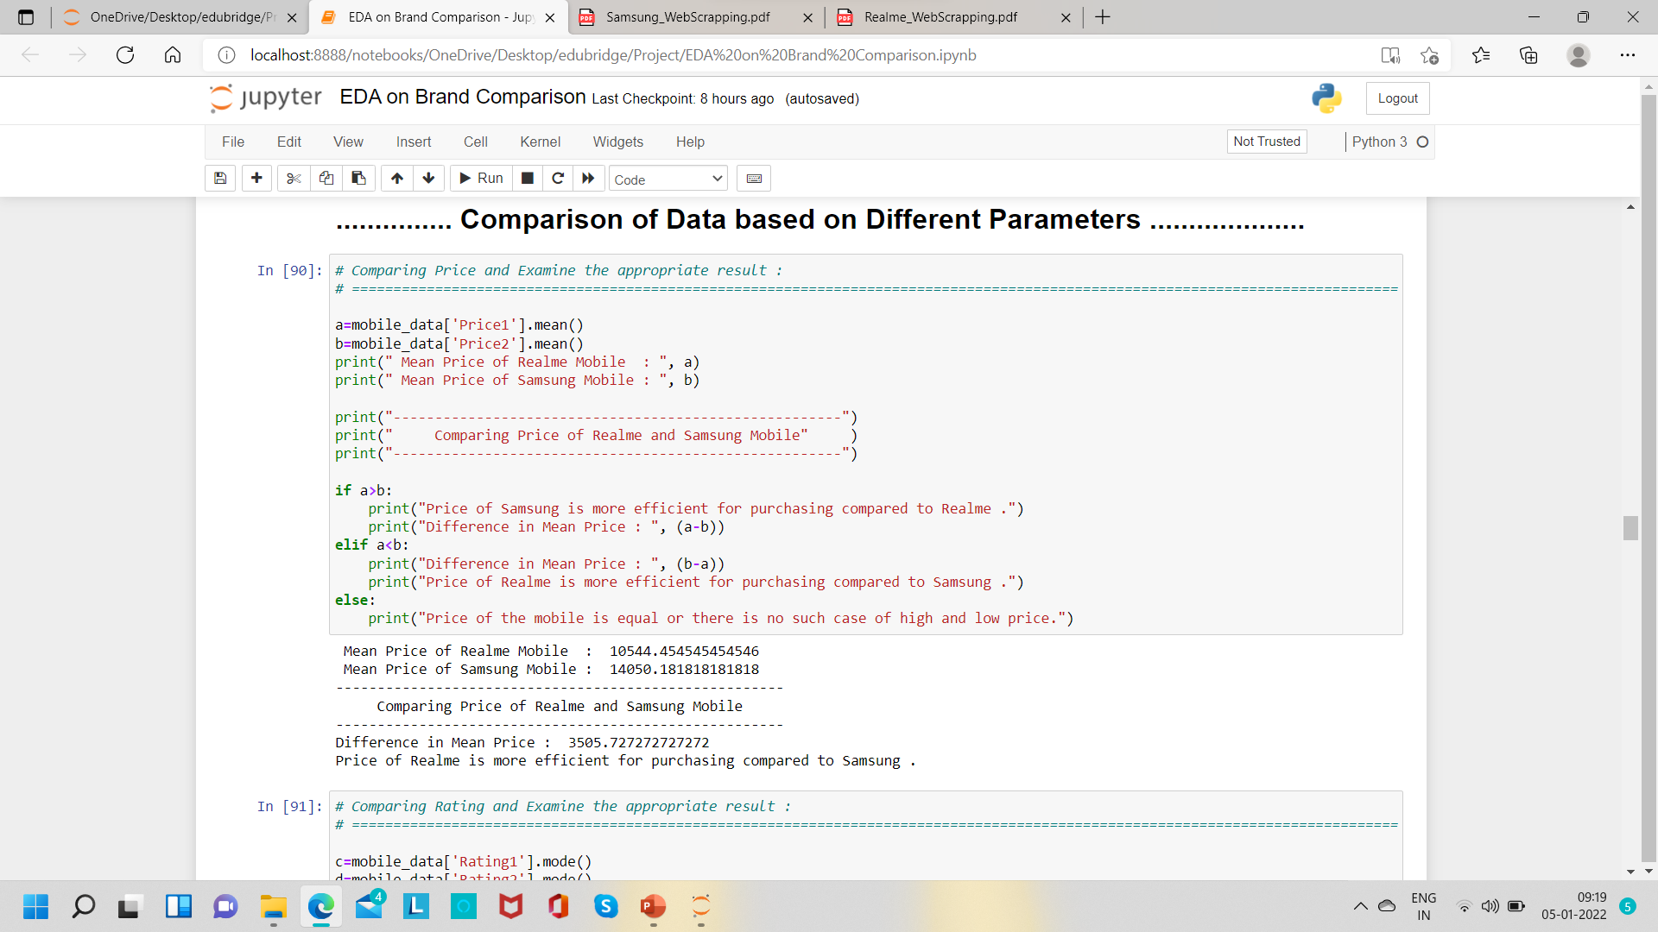
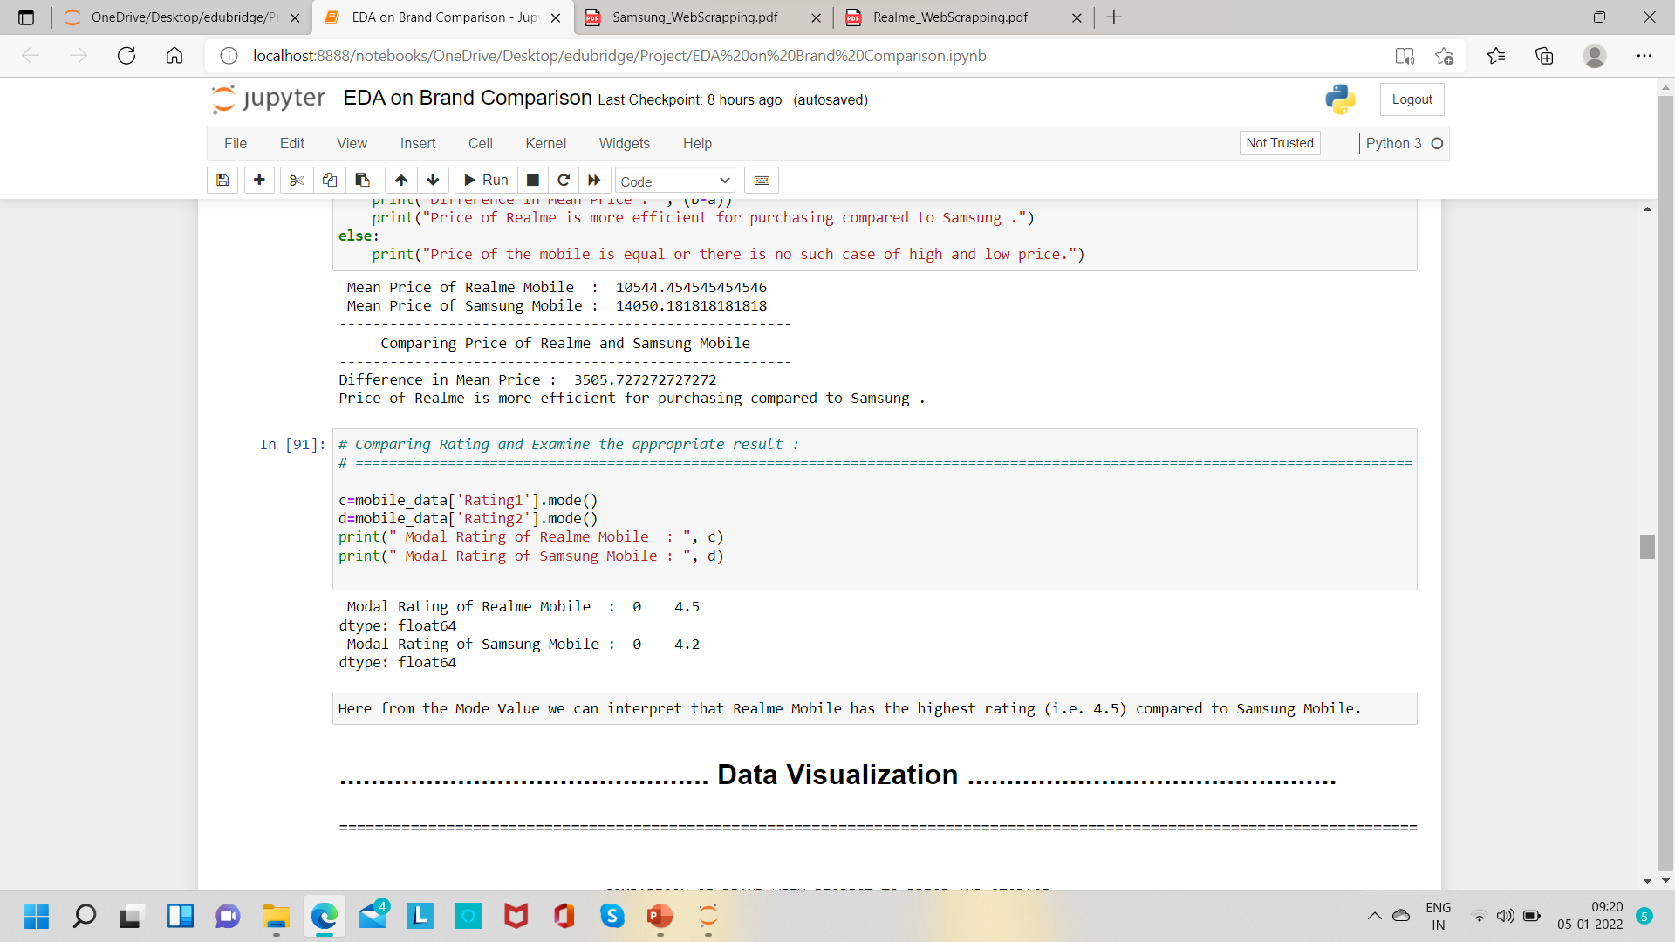
Comparing

Slide 26
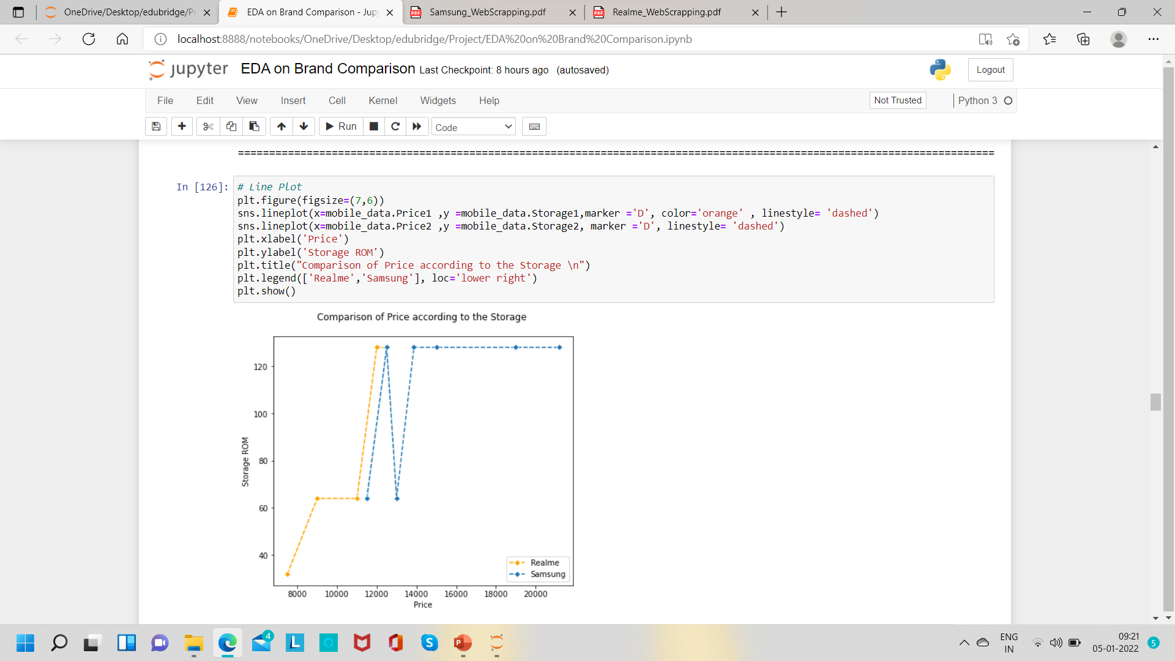
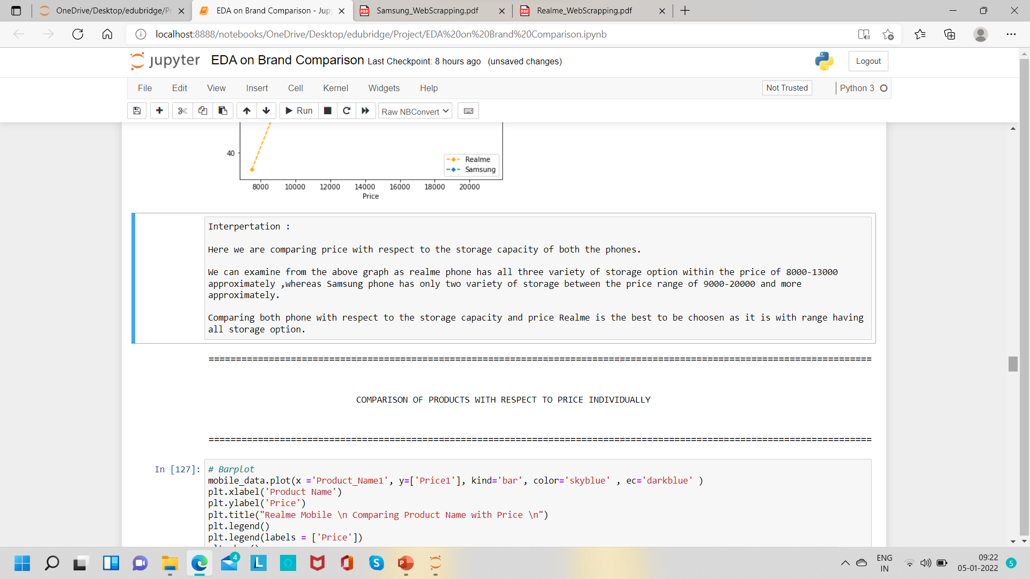
Process 5 :
Data Visualization
COMPARISON OF BRAND WITH RESPECT TO PRICE AND STORAGE

Slide 27
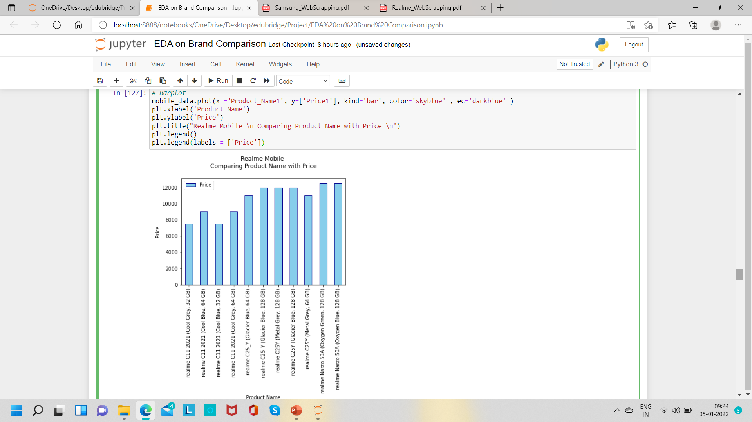
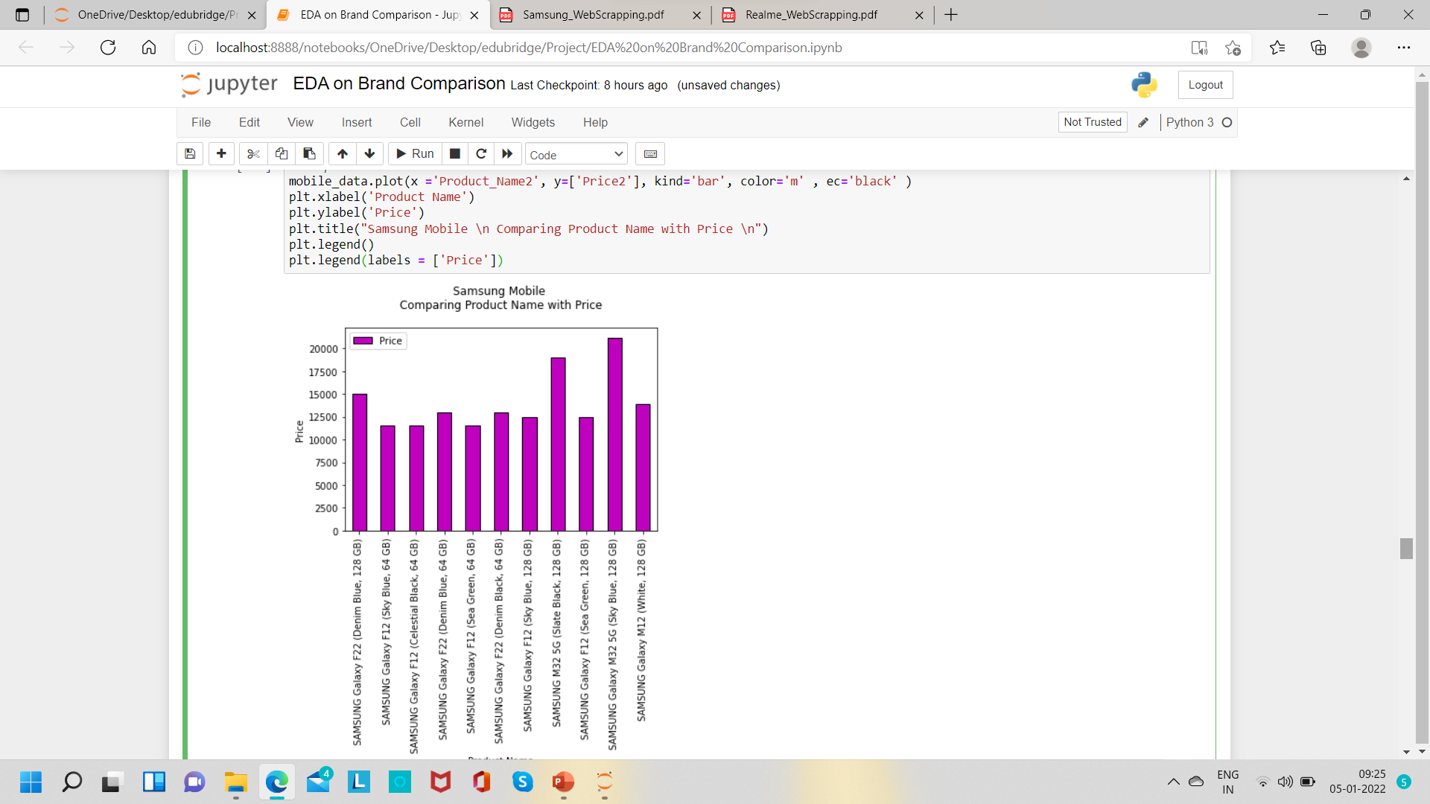
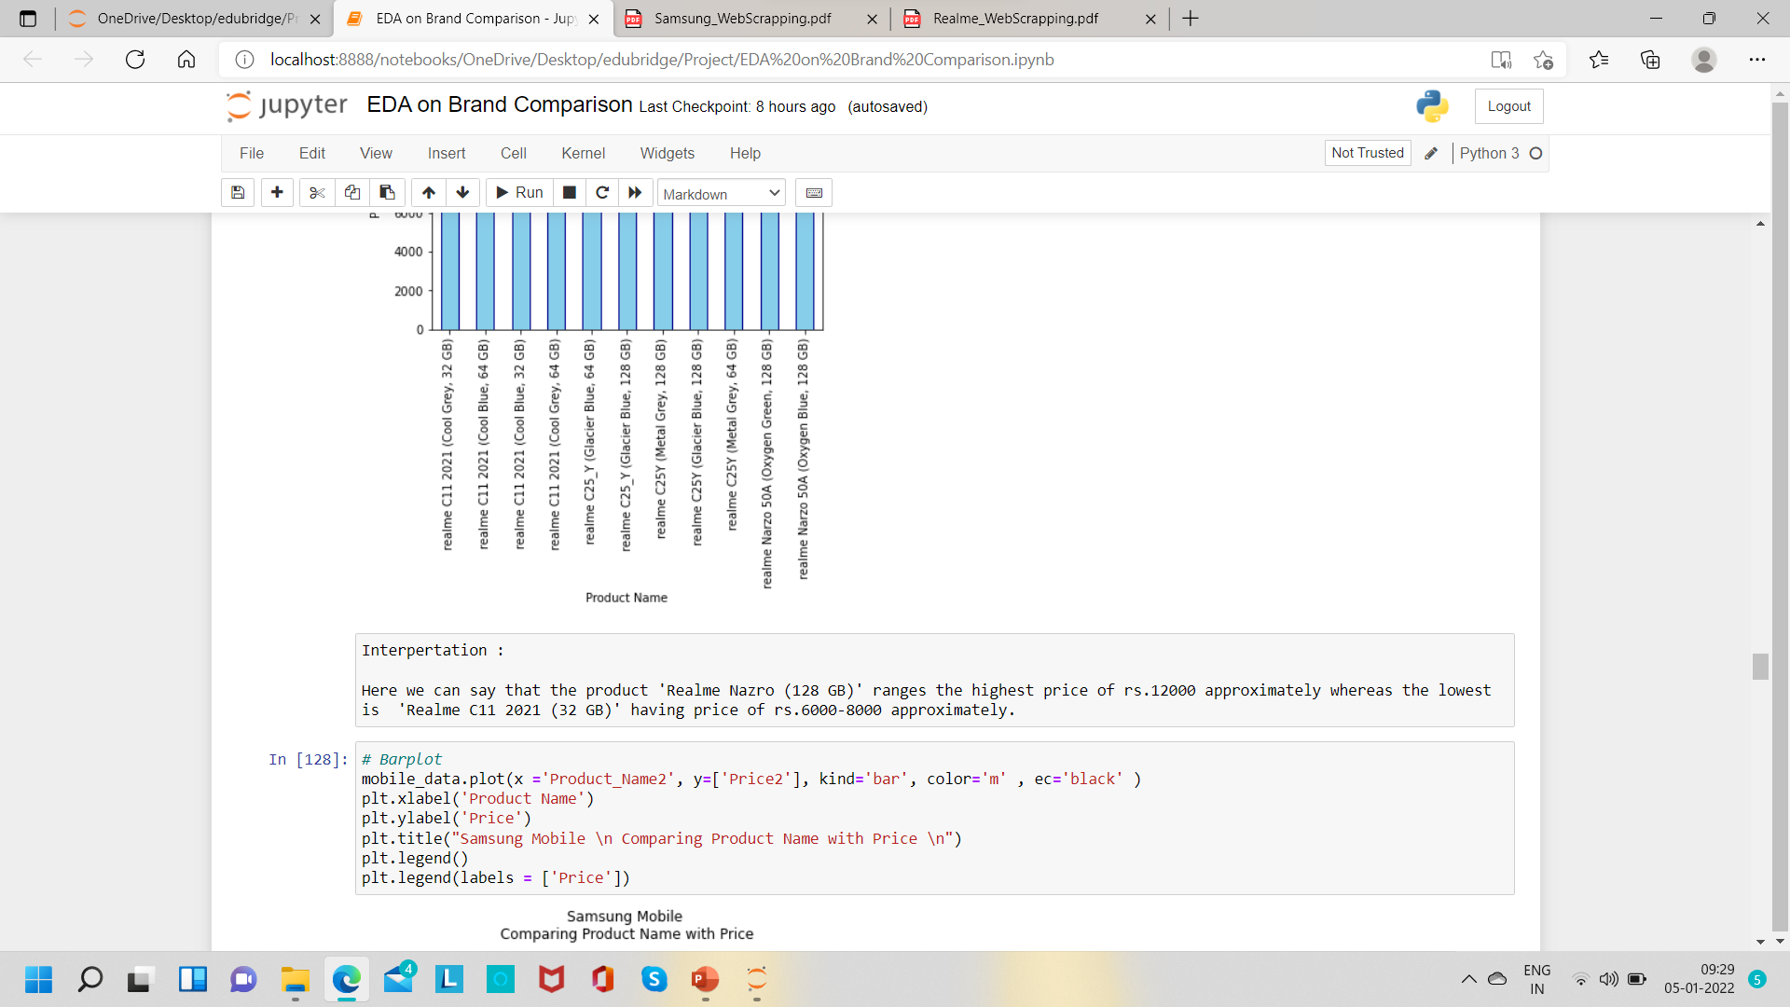
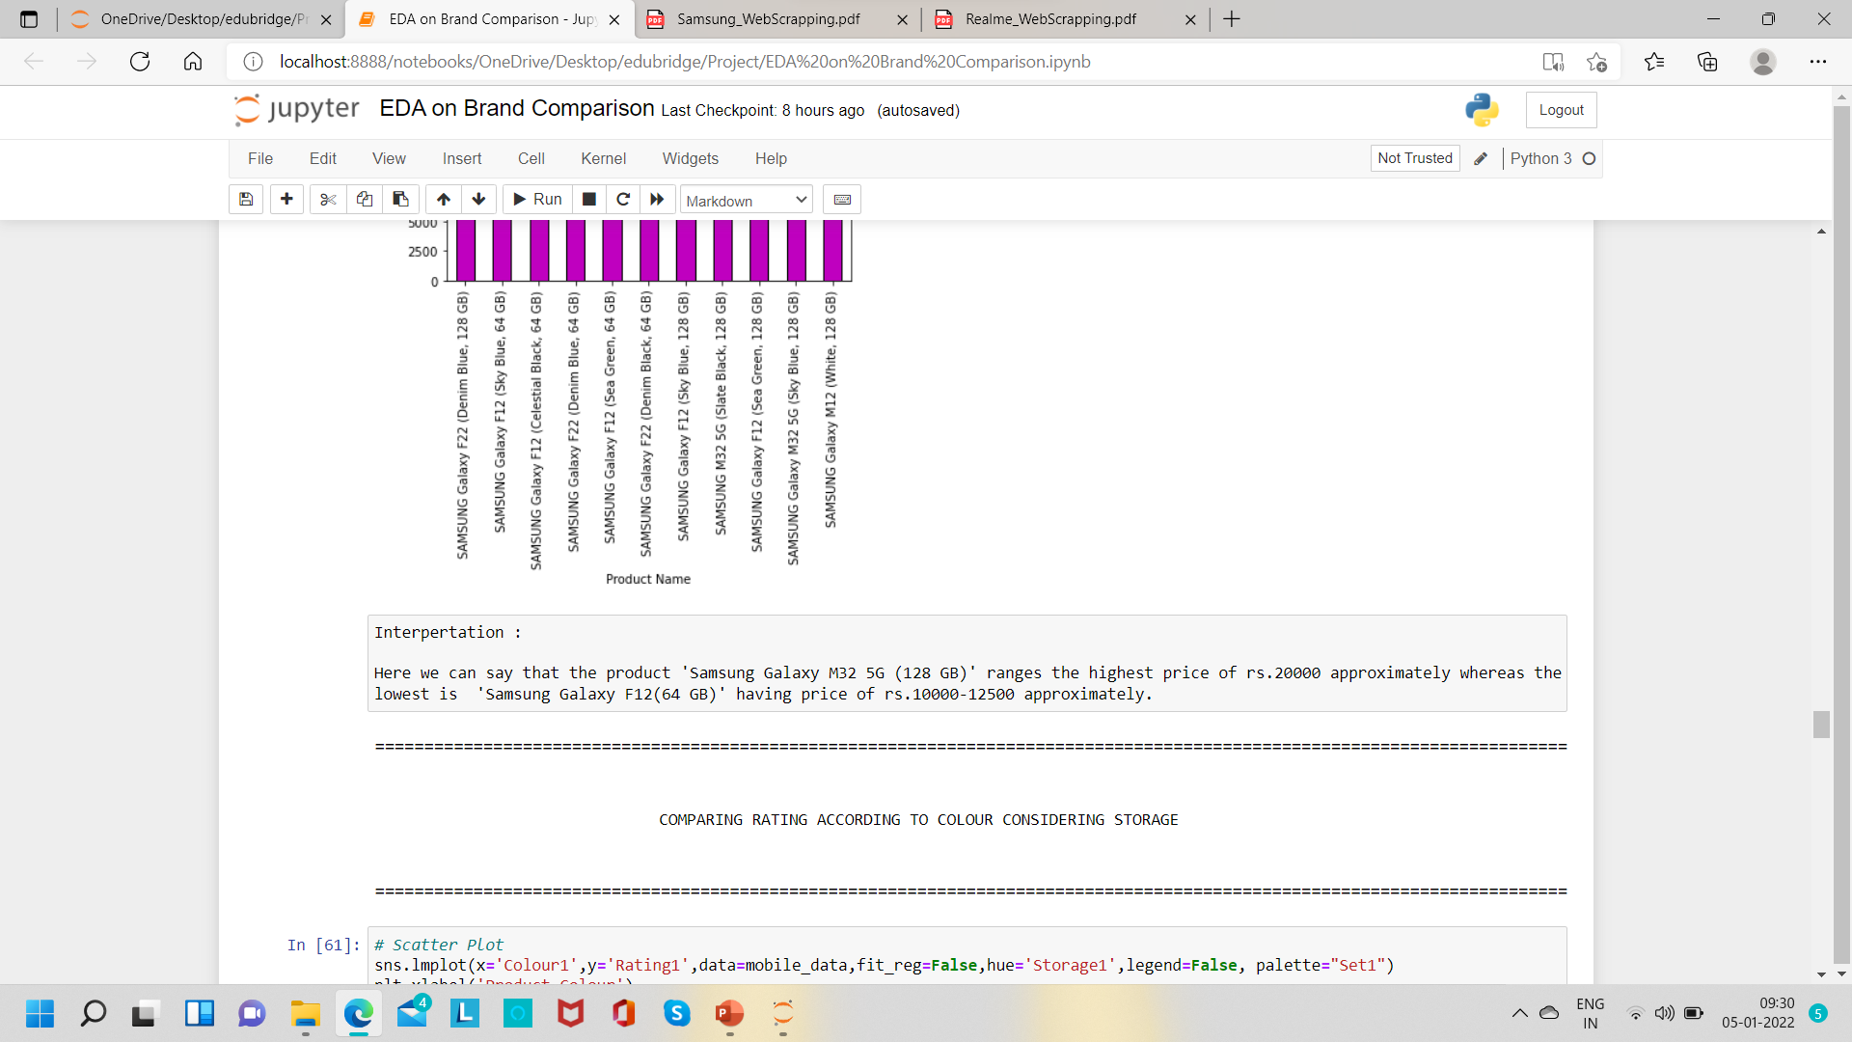
COMPARISON OF PRODUCTS WITH RESPECT TO PRICE

Slide 28
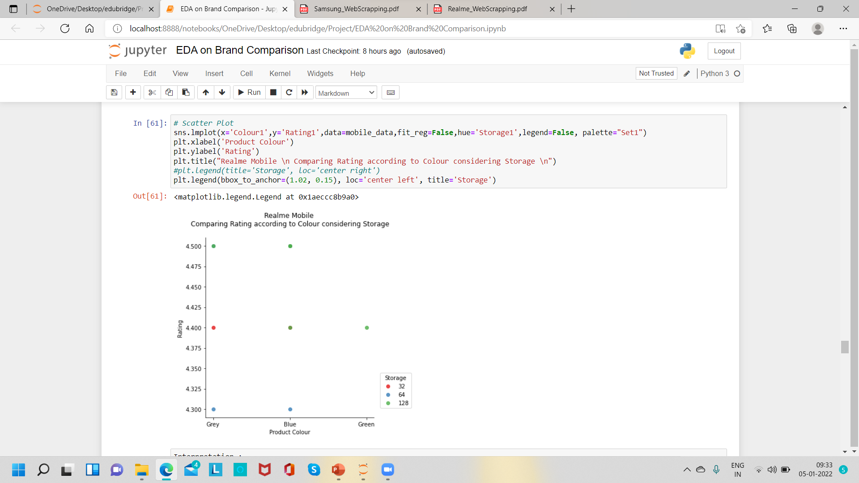
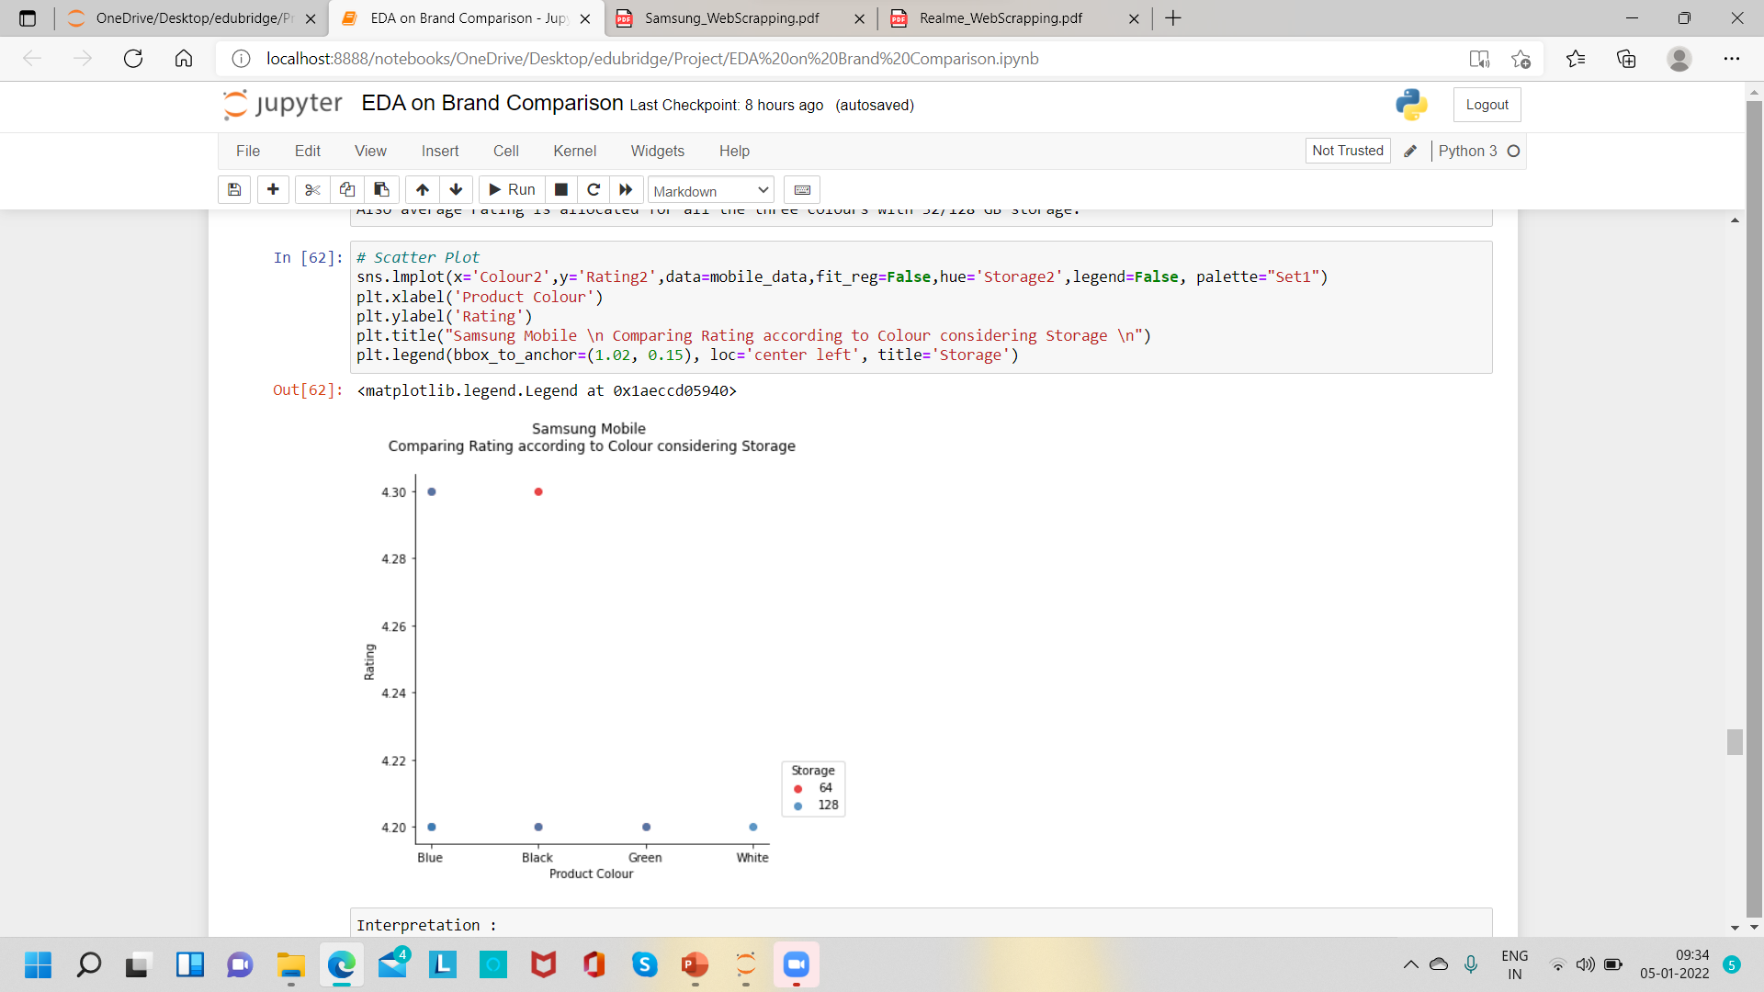
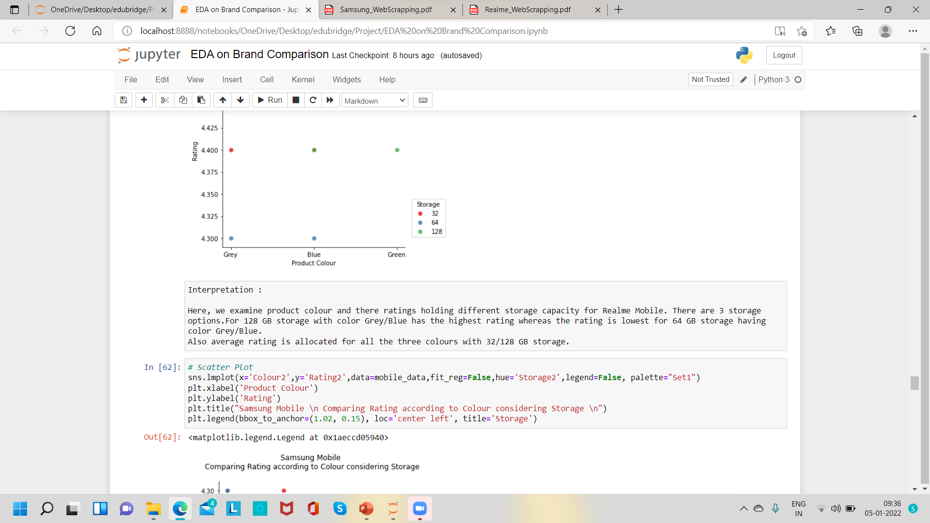
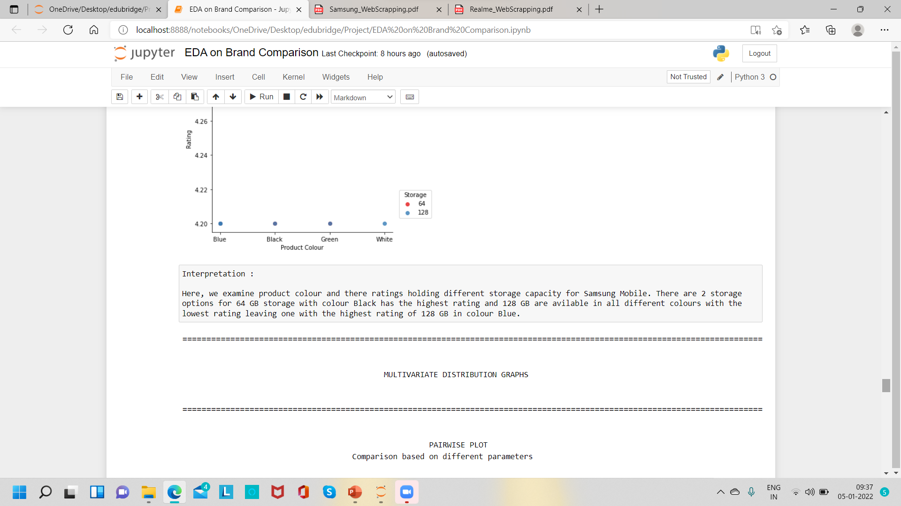
COMPARING RATING ACCORDING TO COLOUR CONSIDERING STORAGE

Slide 29
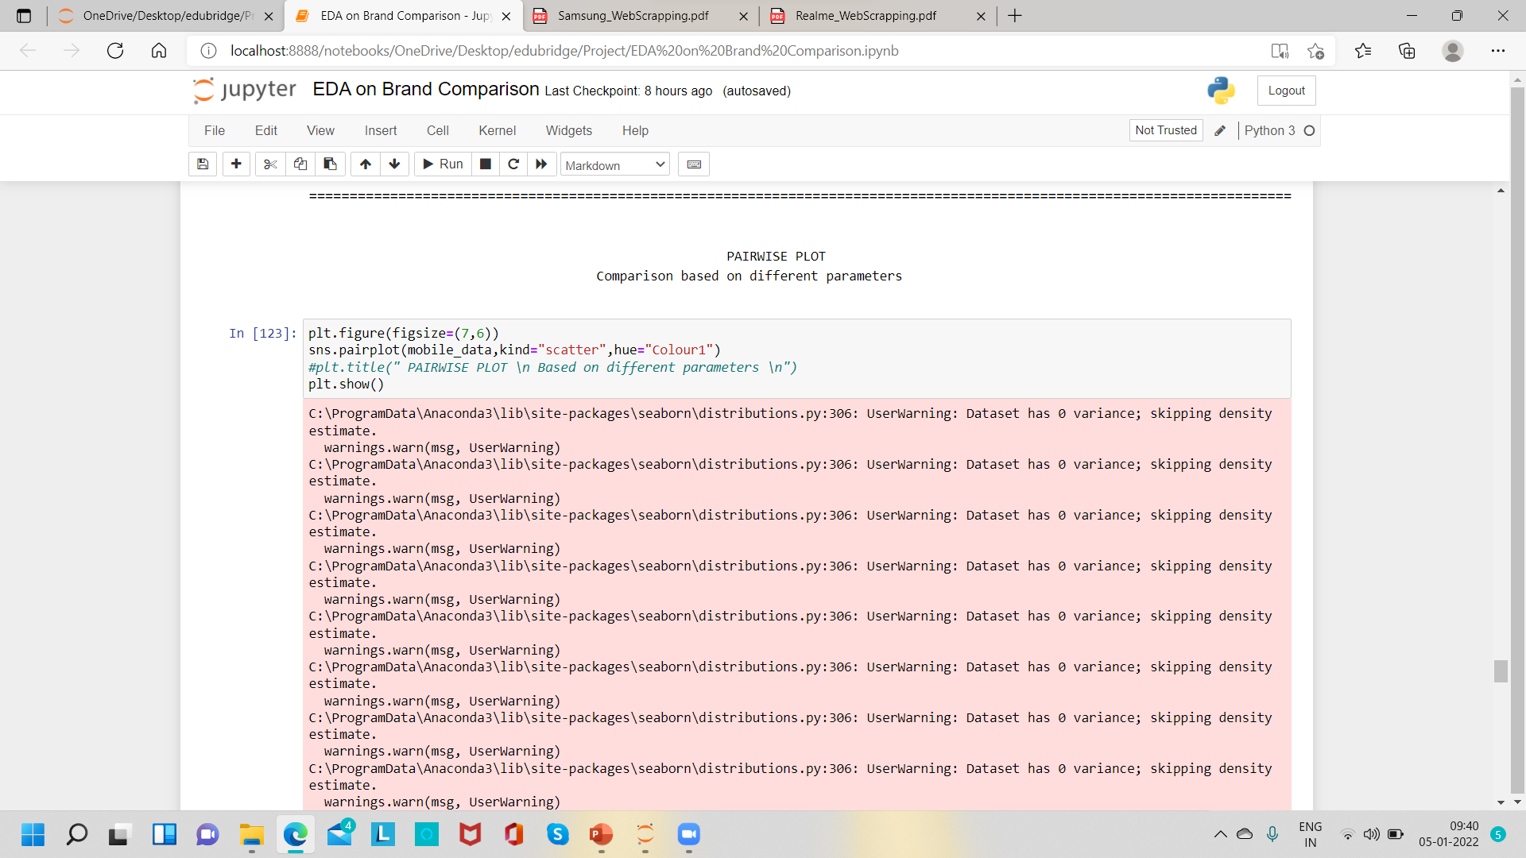
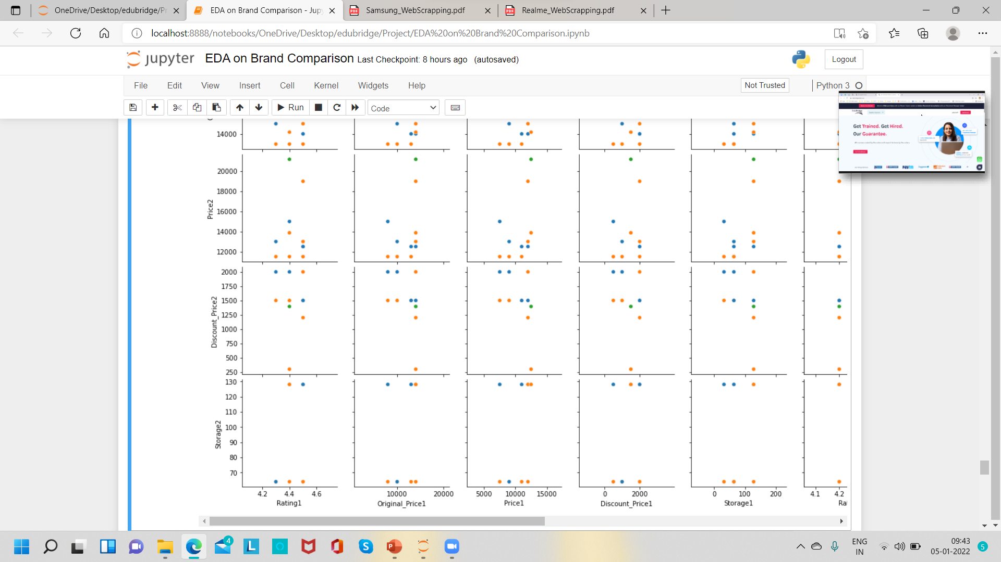
PAIRWISE PLOT
Comparison based on different parameters

Slide 30
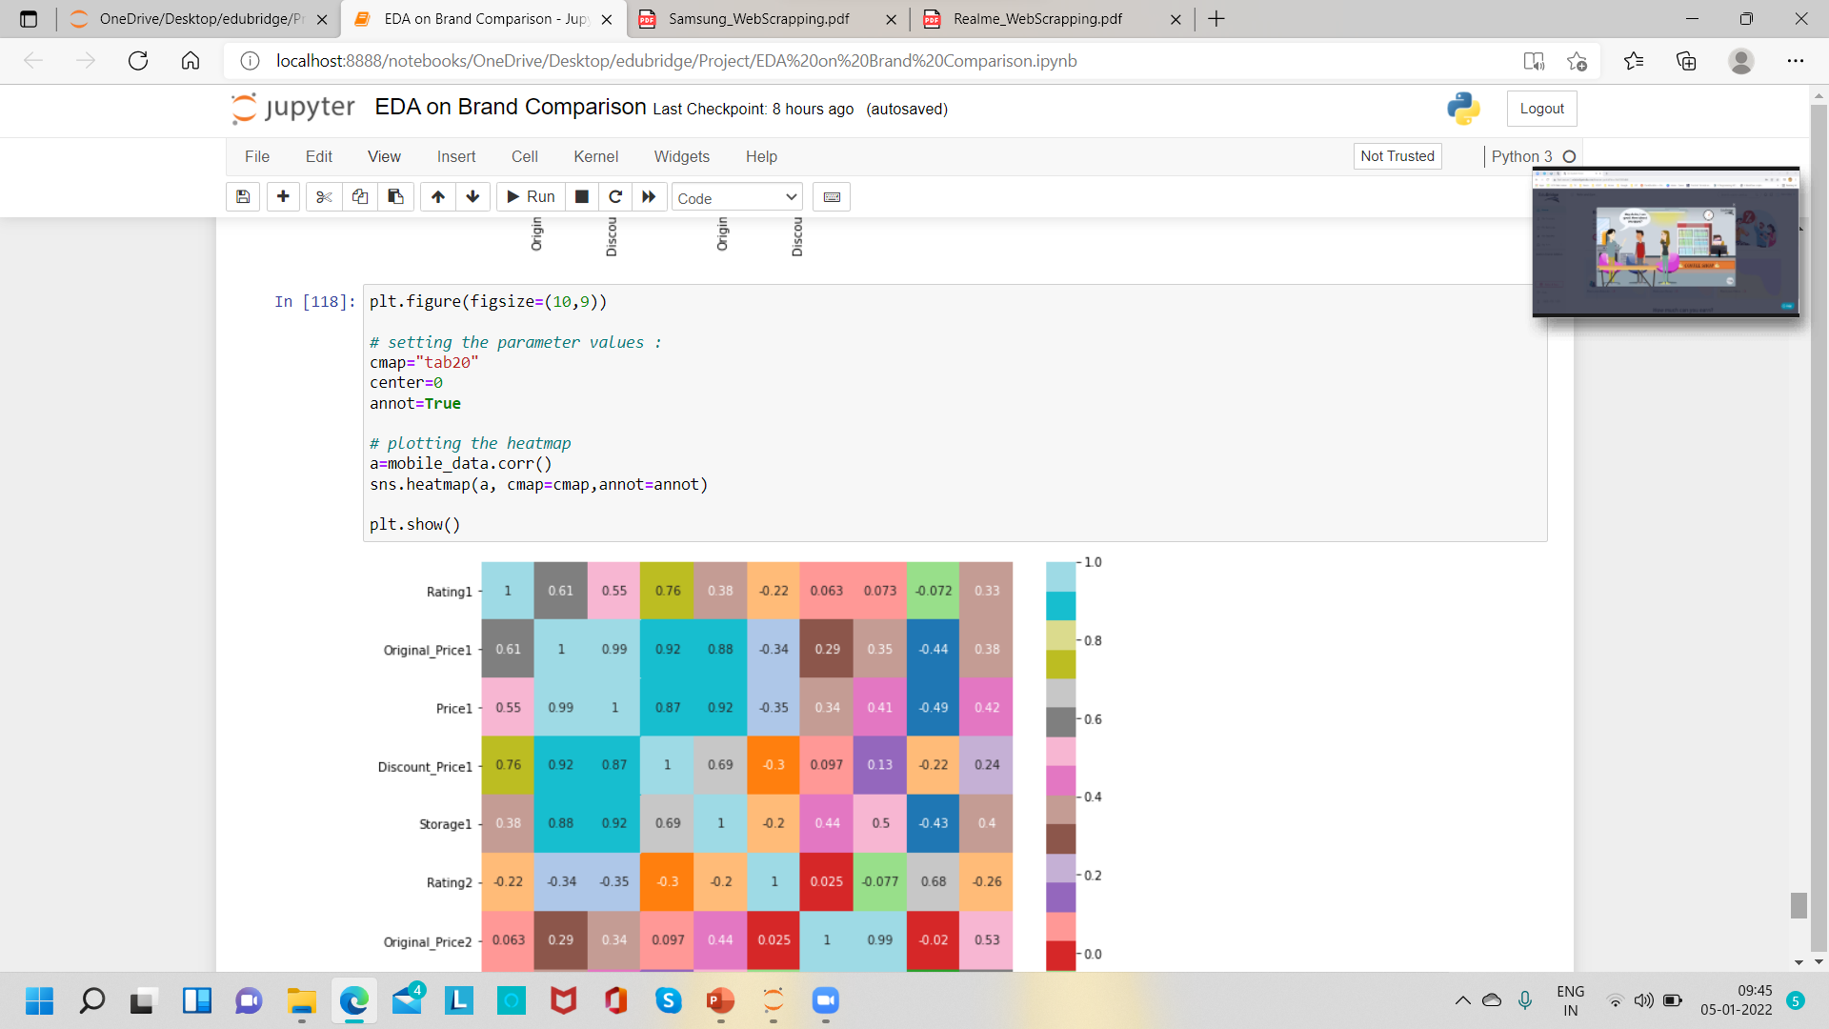
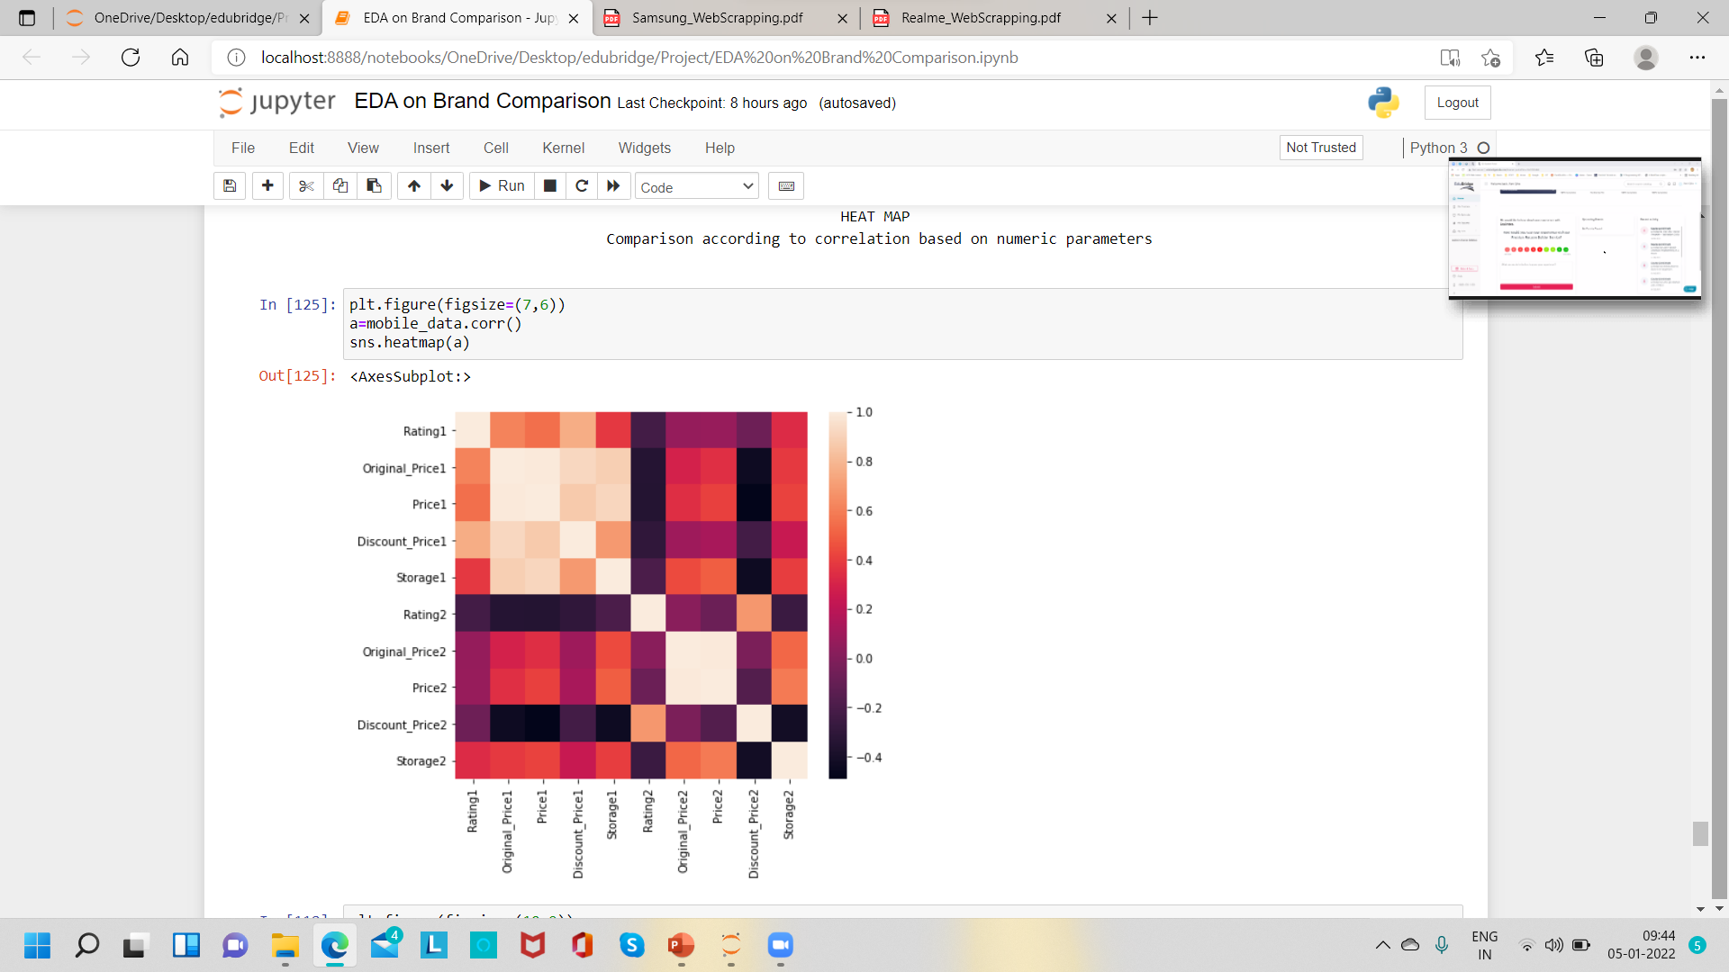
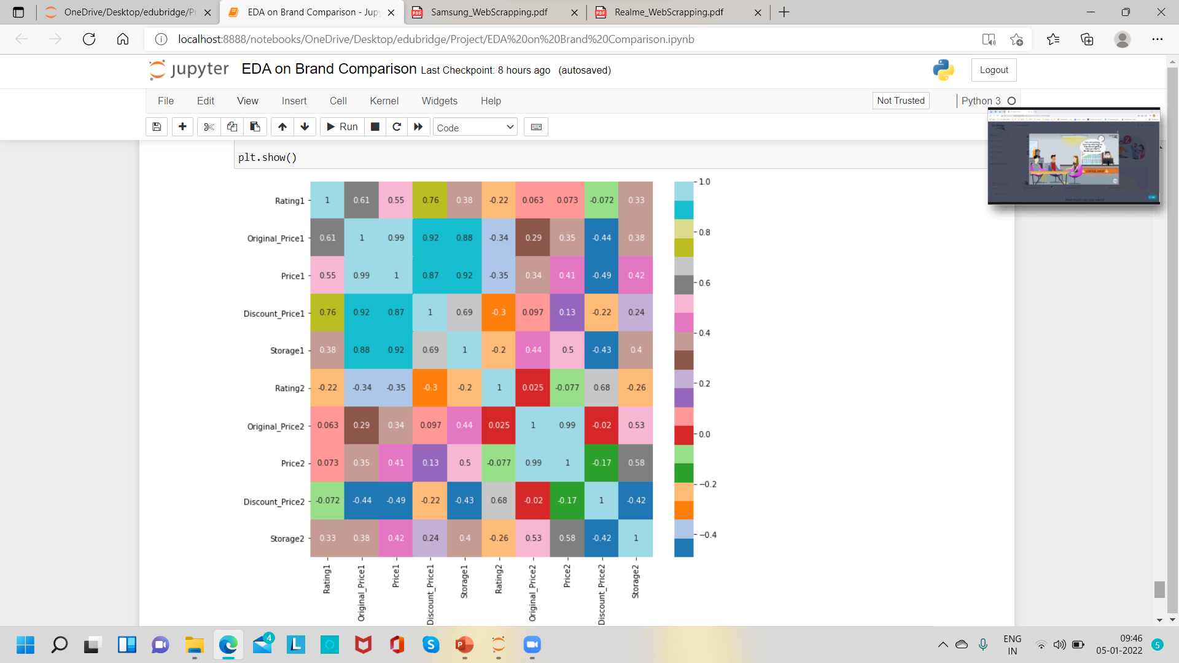
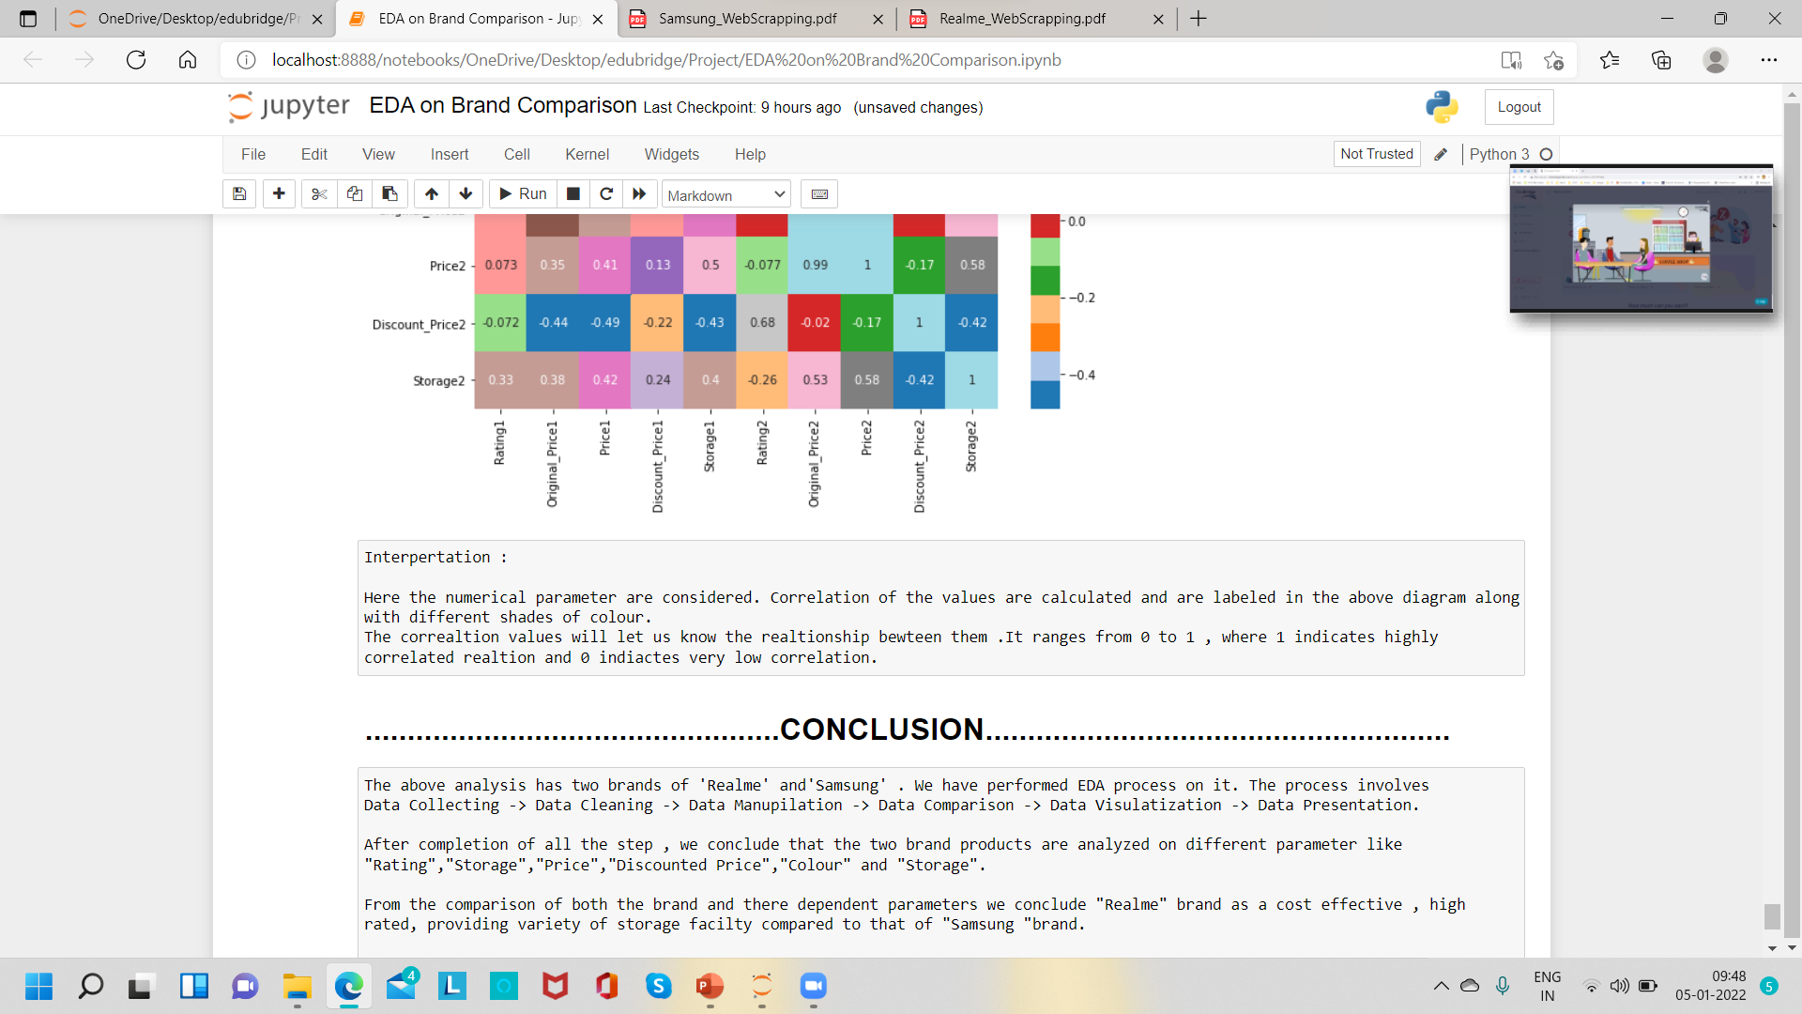
HEAT MAP
Comparison according to correlation based on numeric parameters

Slide 31
Conclusion
The above analysis has two brands of 'Realme' and 'Samsung' . We have performed EDA process on it. The process involves
Data Collecting -> Data Cleaning -> Data Manipulation -> Data Comparison -> Data Visualization -> Data Presentation.
After completion of all the step , we conclude that the two brand products are analyzed on different parameter like "Rating”, "Storage”, "Price”, "Discounted Price", "Color" and "Storage".
From the comparison of both the brand and there dependent parameters we conclude "Realme" brand as a cost effective , high rated, providing variety of storage facility compared to that of "Samsung "brand.
Samsung brand fails in providing storage facilities within best cheap price and is low rated.
According to our analysis "Realme" is the best choice compared to "Samsung".

Slide 32
Thankyou
Divya Arunthathiar

